Slide 1
Open Your Research without opening your wallet
October 20, 2015
Janelle Wertzberger, Musselman Library
Notes:
Happy Open Access Week! Open access not really “news” anymore. We appear to have reached a tipping point in terms of how many scholars know what it is and how it benefits them. Certainly more funders and universities encourage or even require it. Many authors have moved beyond the “should I publish open access” question and on to the “how do I published open access” question or (a subquestion) “how can I afford to publish open access.” That will be the main topic for today.

Slide 2
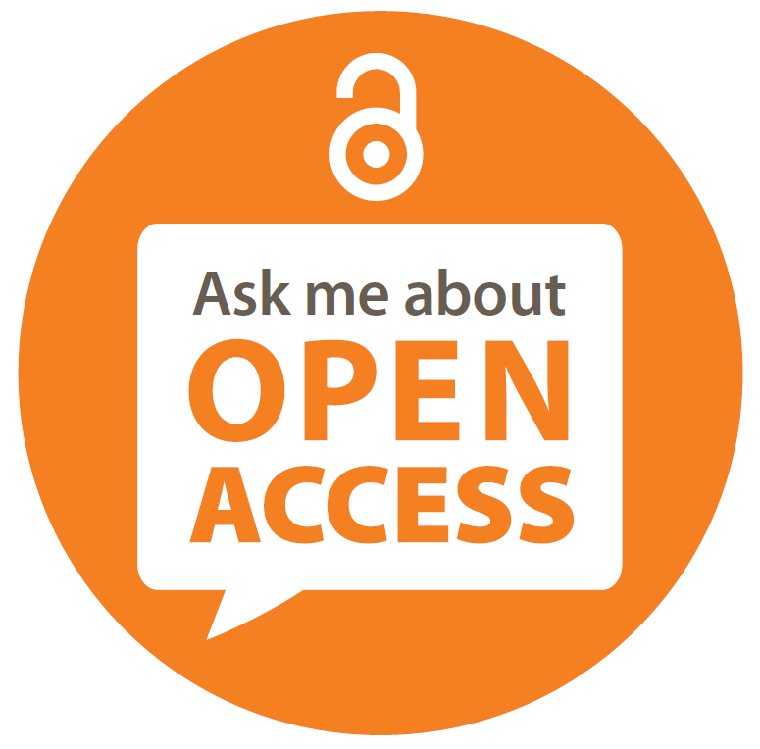
How does open access benefit authors?
Discoverability & visibility
Citation impact
Author rights
Funder criteria
NIH Public Access Policy (2009)
OSTP Memo (2013)
Gates Foundation, Howard Hughes Medical Institute, and more
Notes:
But just to get up to speed and make sure we’re all together, I’ll quickly review the benefits of open access.
Discoverability and Visibility. Open publications are findable on the free web. Many open access platforms have been optimized for search engine discovery. Potential readers never hit a paywall when the work is open.
Citation impact. Many studies have measured that open works are cited more frequently than closed works. The “citation advantage” varies by discipline but it is always an advantage.
Author rights. Authors increasingly want to maintain some degree of control over their work. Thinking about which aspects of copyright you’d like to retain is important, and publishing openly can help you manage the rights you’d like to keep and exercise.
Funder criteria. Many granting agencies now require the open sharing of research results and even research data. They pay for the research to happen and don’t want to pay again to read it. Publishing in an OA journal or self-archiving in a repository like The Cupola can help meet your funder’s requirements.
The NIH took the lead on this back in 2009.
In 2013, the White House Office of Science and Technology Policy issued a memo directing “federal agencies with more than $100M in R&D expenditures to develop plans to make the published results of federally funded research freely available to the public within one year of publication and requiring researchers to better account for and manage the digital data resulting from federally funded scientific research.” https://www.whitehouse.gov/administration/eop/ostp/library/publicaccesspolicy Agencies had 6 months to produce a draft plan for compliance. Those plans have been trickling out in final form over the past year or so (see http://sparc.arl.org/advocacy/national/directive for a list of agencies covered and links to their public access plans)
Private funders like the Gates Foundation and HHMI are also embracing open access as a way to increase impact.

Slide 3
Open publishing (green and gold)
Repositories
No cost to author
Journals
Author sometimes pays
Ex: Digital Commons, DSpace, arXiv, PubMed Central
Journals may be completely open or hybrid
Notes:
From here on out, I’ll speak with the assumption that we generally value “open” over “closed,” all other things being equal. What do you need to know to increase your openness?
Here is the basic landscape of open publishing: green and gold
Green = repositories. Repositories can be institutional (like The Cupola) – or subject-based (like arXiv, Social Sciences Research Network, MLA Commons, etc.)
Gold = journals.

Slide 4
Journals
Conventional
Open Access
Hybrid
Free to submit
Pay to read
Free OR pay to submit
Free to read
Notes:
The journal landscape can be a little complicated so let’s look at it more closely. There are two main categories: conventional journals and open access journals.
Conventional journals:
Free to submit (or perhaps they have page charges or color figure charges)
Pay to read
Open Access journals:
Free OR pay to submit
Free to read
Hybrid
Pay to liberate a single article
Journal is mostly pay to read, with selected free articles (and sometimes publishers sell the free ones!)
This is the category many faculty authors are most aware of, because of direct emails from publishers. This is also my least favorite option. Some people call it “fool’s gold.” I really don’t support spending College funds on this option.
So let’s assume that you’re looking for an open publishing outlet and you don’t have access to funds. (Though if you’re grant-funded, think about asking for support to publish open up front next time... Some authors also use startup funds to publish open) What are your options? I have some tips...

Slide 5
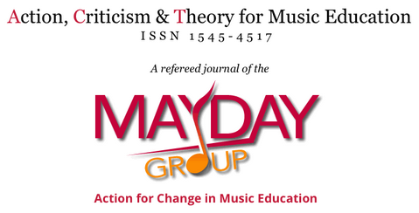
1. Many OA journals do not charge authors at all
Notes:
This is big news to many scholars: many OA journals DO NOT HAVE an APC! They are still peer-reviewed and high quality; their financial support model is just not based on subscriptions and shareholder profits.
Open Library of Humanities
New – just launched at end of September
One humanities megajournal (kind of like PLOS ONE) and six very specific journals hosted on their platform – all peer-reviewed
NO author-facing fees
Financed by Mellon Foundation and library supporters
This “no charge” model is more common on the humanities end of the spectrum than the science end. Some examples of Gettysburg faculty publishing in OA journals:
Brent Talbot in Action, Criticism, and Theory for Music Education
Jing Li in Indian Folklife
Michael Birkner in New Jersey Studies
Divonna Stebick in Educational Practice and Reform
Betsy Lavolette in Language Learning & Technology
Darren Glass in Integers
Sometimes a new OA journal will waive author fees for the first issue or issues in order to generate quality submissions and establish itself. We’ve had faculty take advantage of this. Examples:
Josef Brandauer in Physiological Reports (fee waived for first 100 accepted articles)
Monica Ogra in Earth System Dynamics
eLIFE is a peer-reviewed, life science and biomedicine journal that started in 2012 and has NO AUTHOR FEE. It is supported by HHMI and the Wellcome Trust (UK). The recent discovery of H. Naledi (the homonid species found in South Africa) was reported in eLIFE.
A lot of these journals are newer. They may not be familiar to you from your years of graduate training because they didn’t exist yet. To learn which OA journals cover your subject (and whether they charge a fee), consult the DOAJ Directory of Open Access Journals. Or ask your librarian liaison to help identify OA journals that cover your research.

Slide 6
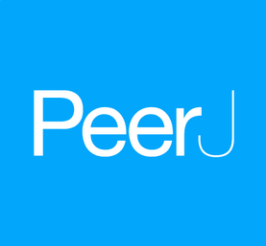
2. Some OA journals have a nominal charge
Pay once, publish for life
Notes:
I know I just said you wouldn’t have to open your wallet at all... But if the fee is modest, it can be a lot easier to get it covered by the Provost’s Office or a project budget or maybe even a department budget. When I say “nominal,” I mean a few hundred dollars or less.
PeerJ – motto is “pay once, publish for life”
The platform has two journals right now: PeerJ (biological and medical sciences) and PeerJ Computer Science. Both are peer-reviewed and open access.
A basic membership costs $99 per author and allows you to publish one article per year, for life
Their most expensive membership is $299 (per author) which allows an unlimited number of published articles, for life
Undergraduates publish for free
They also ask authors to contribute one question, comment or peer review (if qualified) to the community every 12 months to keep their membership active
The PeerJ journals are indexed by all the big databases (PubMed, Scopus, Google Scholar, ACS, ACM, etc.)
PeerJ started publishing in 2012 and received its first (partial) Impact Factor in June 2015: 2.1. I predict it will go up. We’ll see how PeerJ Computer Science looks soon!
Another example of a nominal fee: Applied Economics and Finance (Rimvydas Baltaduonis) - $300 APC

Slide 7
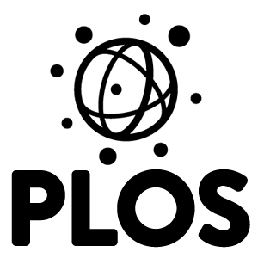
3. Expensive journals usually have waiver policies
$2,900
PLOS Biology
PLOS Medicine
$2,250
PLOS Computational Biology
PLOS Genetics
PLOS Pathogens
PLOS Neglected Tropical Diseases
$1,495
PLOS ONE
Notes:
At last count, Gettysburg faculty members have published in PLOS ONE 12 times. The APC was $1350 for a long time – it just went up to $1495 (as of 10/1/15).
But how many of our faculty actually paid that fee?
Many say co-authors covered it
One said he raised funds by conducting workshops
At least two said they asked for a waiver, since they didn’t have publishing money in their research budgets and their institution did not have an OA publishing fund. They got the waiver.
Publication fee policies always talk about waivers to authors in developing countries, which we definitely are not. But we don’t have the funding infrastructure to support this the way that R1 schools do, and it’s worth pointing that out. If you don’t ask, you don’t get.
DO WE HAVE ANY OTHER WAIVER STORIES TO SHARE?

Slide 8
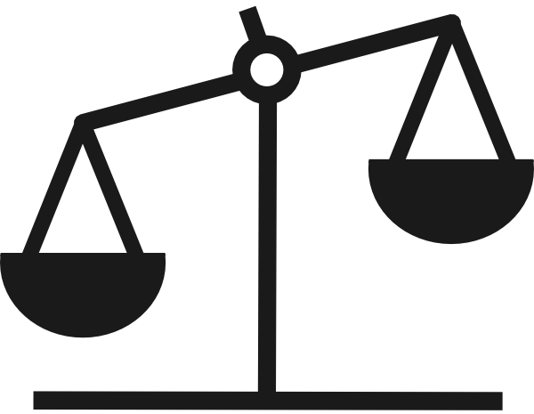
4. Exercise your right to negotiate your publishing contract
Author
Publisher
The right to reproduce the work
The right to distribute the work
The right to prepare derivative works
The right to publicly perform the work
The right to publicly display the work
The right to license any of the above to third parties
Scale clip art by Scott Kirkwood (freeware)
Notes:
Too many authors sign the default contract, which tends to give the publisher ALL the rights and leaves the author with NONE of them! But contracts can be negotiated. If you don’t ask for what you want, there’s little chance that you will get it.
Last year during Open Access Week I gave a presentation called “Did I sign my rights away? Copyright for authors.” It covered how to read your contract and provided guidance about navigating the legalese. My hope was to help authors to understand the discrete rights included under the copyright “umbrella” and empower them to negotiate contracts that are unsatisfactory. You can view those slides (I put them in The Cupola for public access) or we can talk more about it when you see your next contract. I’m not a lawyer (I have to say that!), but I’m happy to consult with authors about contracts. I have been working with a number of authors to provide clarification about the contract and language to substitute. Many authors have been successful with negotiating.
(A Gettysburg professor recently had to pay Taylor & Francis $108 to reuse words of his own published article in his new book. He’s hopping mad.)
See http://cupola.gettysburg.edu/oaweek/2014/oaschedule2014/4/

Slide 9
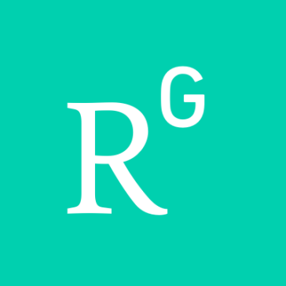
5. Self-archiving is always free
Gettysburg faculty published 165 items in 2013
53% are open in The Cupola
Gettysburg faculty published 143 items in 2014
63% are open in The Cupola
Notes:
Are you familiar with the term “self-archiving”? The article I sent you (https://www.insidehighered.com/blogs/library-babel-fish/open-access-without-tears) used it, but I’m not sure how common it is. It basically means that you can put the work on the open web. Sharing your publications in The Cupola is a form of self-archiving. So is posting them to your personal website or ResearchGate or academia.edu.
BUT! The caveat is that the author doesn’t decide to self-archive. The COPYRIGHT HOLDER determines whether the author can self-archive.
If you haven’t signed a contract yet, you can screen for this. Will your publisher allow you to self-archive? If not, consider negotiating.
If you already signed your contract, you need to learn what you agreed to. Librarians can help with this. Our first stop is always the SHERPA/RoMEO database, which aggregates journal publisher policies about self-archiving. We also read the fine print on publisher websites. And when we don’t see the answer we want, we email the publisher directly and ask permission to put your work in The Cupola. The results are promising. In 2013, 53% of all Gettysburg faculty publications were fully open in The Cupola. In 2014 it was 63%. Fingers crossed it continues to rise in 2015.

Slide 10
Preprint / Submitted Manuscript
Postprint / Accepted Manuscript
Final pdf / Publisher version
Janelle’s position:
Something is better than nothing
Increased discoverability of your work in any form will result in increased access to the work in final form
Notes:
Here is a sticky detail that vexes a lot of authors. Sometimes a publisher will permit self-archiving, but only of a certain version of the article. These are the 3 versions:
Preprint is the pre-refereed manuscript as initially submitted to the publisher. Note: the author is the copyright holder of this document, no matter what the publisher says.
Postprint is the accepted version of the manuscript, after refereeing. It is not yet laid out in the journal’s final format.
The final pdf or publisher’s pdf is the final and most desirable version of your article. It is formatted in the style of the journal, complete with running headers/footers and with the journal issue pagination. Your publisher may send you a courtesy copy of this. Sometimes it’s called a “reprint” (old term for when the publisher actually sent authors a box of hard copies to hand out to colleagues).
Naturally we would prefer to include the final version in The Cupola... But sometimes publishers only allow an earlier version to be self-archived. When this is the case, we defer to the author’s preference. Some are fine with earlier versions, some are not. Sometimes I think that a scholar’s discipline informs their preference, but sometimes I think it’s more personal preference. There are some disciplines that value the public sharing of early drafts and others that are more secretive about work in progress.
My personal position is:
Something is better than nothing
Increased discoverability of your work in any form will result in increased access to the work in final form
...but every author needs to consider this for her or himself.
There’s another facet to self-archiving that I should mention. I’ve talked about what is legal and what a scholar prefers. But those two things don’t always sit well together. I mentioned that sometimes the publisher allows a preprint or postprint to be self-archived, but the author doesn’t want that version to be public. What about the inverse situation? What if you want to share the final version but your contract doesn’t let you? There are scholars who ignore the rights of the copyright holder and do whatever they want with the work. It is technologically simple to self-archive the publisher’s pdf, even if it violates the contract the author signed. There are a lot of publications illegally posted on the internet! If you self-archive in The Cupola, we will make sure everything we post is legal and we won’t post what isn’t (that’s why we don’t have 100% open faculty publications). If you’re self-archiving outside The Cupola, you assume the responsibility of copyright compliance.

Slide 11
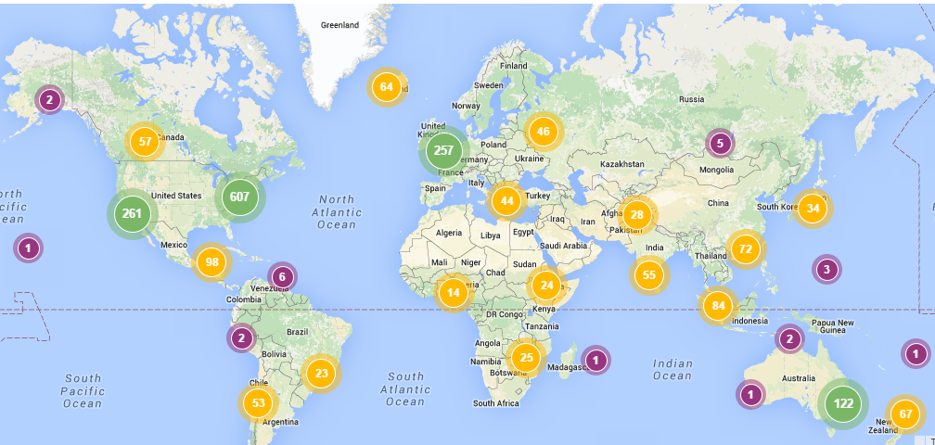
The Physiological Consequences of Bed Rest (Drury & Stuempfle 2007)
3,369 downloads 82 countries
Notes:
Here’s a visual representation of how opening a work impacts access - everywhere.
2007 – published in Journal of Exercise Physiology
7/24/13 – added to The Cupola
As of 10/19/15:
3,369 downloads (just in The Cupola)
82 countries
Most referrals from Google (in various countries)
Not sure how many downloads it had from publisher site.
This slide highlights how many readers come from outside the U.S. (Less than 1/3 of all downloads are from the US.) Lack of access is a global challenge! This is a little outside the scope of today’s talk, but it’s easy for us to forget from within our bubble of information privilege. Many potential readers simply do not have access to the subscription literature, even if they are working in academia, and even if they are in the U.S.

Slide 12
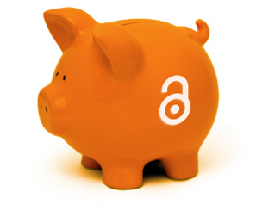
http://openscience.com/wp-content/uploads/2013/01/OA_piggybank.jpg
Notes:
I want to end on a positive note. There are lots of ways to reap the benefits of open access without paying for it directly. Of course, someone has to pay for it... But if you can find a good OA outlet for your research that is linked to a support model that doesn’t lean on the author’s wallet, you can publish open.
I was debating whether to use the phrase “sustainable excellence” today or not. It’s a given that we aren’t going to find new funding for initiatives like this without reallocating from currently funded projects. I think it’s unlikely that Gettysburg will establish an OA publishing fund to pay author fees. That said, Musselman Library is committed to helping support the transition to a more open system of scholarly communication to the best of our ability. The cornerstone of that support is our investment in the college’s institutional repository. We pay an annual subscription for the platform, but we can host as many items on it as we want. The cost per item is far less than paying APCs for every faculty publication... And we also have the capability to share student research and other college materials.
Bottom line: we want to help you publish open. We don’t want to direct any more Gettysburg money to commercial publishers who are already making double digit profits on free academic labor. We can serve the interests of our authors and researchers in other ways.
(Elsevier made a 37% profit in 2012... Big pharma only hit 16% and the oil industry was at 6.5%. - M.P. Eve Open Access and the Humanities)

Slide 13
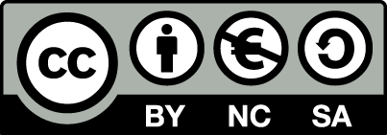
This work was created by Janelle Wertzberger for an Open Access Week presentation at Gettysburg College on October 20, 2015.
Some material adapted from Being Open As An Early-Career Researcher (Erin McKiernan, OpenCon2014).
It is licensed under a Creative Commons Attribution Non-Commercial Share Alike 4.0 International license: http://creativecommons.org/licenses/by-nc-sa/4.0/
Notes:
McKiernan, E.C. (2014). Being open as an early-career researcher [PowerPoint slides]. Retrieved from http://figshare.com/articles/Being_Open_As_An_Early_Career_Reseacher_OpenCon_2014/1243319

