Slide 1
Launching an institutional repository and library publishing platform with Digital Commons
Zach Coble, Systems & Emerging Technologies Librarian
Carolyn Sautter, Director of Special Collections & College Archives
Janelle Wertzberger, Director of Reference & Instruction
October 2, 2012
Pennsylvania Library Association Conference

Slide 2
The long conversation 2005-2012
2005 DAMS in Atlanta
2008 DSpace with NITLE and DDPPC on campus
2012 Digital Commons
Notes:
Welcome to acronymland!
2005 – DAMS in Atlanta – The possibilities
Digital Assets Management
At that time Institutional Repository (IR) options included: customizing Fedora, D-Space, Sakai, CONTENTdm, or a homegrown digital asset management system
2008 – NITLE consortium for DSpace – An attempt to talk nationally
National Institute for Technology in Liberal Education
2008 – DDPPC – Information Management on campus
Data/Document Policy and Procedure Committee
2012 – Digital Commons – The product
BePress

Slide 3
Digital assets management
The conversation that kept starting over
How to manage what Gettysburg College has produced electronically
How to encourage the campus community to contribute samples of their scholarly output to the College
Who on campus can make this happen – how and when?
Notes:
Library always part of the investigation
Cataloging and Metadata Librarian

Slide 4
Challenges in 2005
IT reluctant to take on another server
The expense in time and money of customization
The difficulty of supporting and migrating so many formats
The complexities of copyright
The expectation for an easy to use front end
The need for a coordinator

Slide 5
Campus conversation - 2008
Musselman Library plays in the NITLE sandbox as part of a consortium of DSpace users
2008 - DDPPC (Data / Document Policy and Procedures Committee)
Campus could not settle on product, but needed forum for policy discussions
This group had representatives from offices and departments
Cataloging and Metadata Librarian and College Archivist included in discussion
Only focused on risk assessment and records management
Notes:
2008 - Testing the waters
Musselman Library plays in the NITLE sandbox as part of a consortium of DSpace users
Musselman Library sends Cataloging and Metadata Librarian to Tacoma, WA, to meet with the User Group
On campus, have only one professor interested and one student paper uploaded
Information Technology searches for other products but doesn’t find one that can do all for all parties

Slide 6
A new audience for the conversation – 2012
2012 - Scholarly publishing and open access
New Provost interested in Digital Humanities
Campus keenly interested in showcasing high quality student work through annual Celebration
Ready-made product: BePress Digital Commons
Library working group: Reference, Archives, Technical Services and Systems + Liaison network
Notes:
Cataloging and Metadata Librarian now Director of Special Collections part of library working group to design The Cupola

Slide 7
BePress Digital Commons
Hosted with excellent technical support and collaboratory
Active user community – webinars
Friendly front end – easy to customize
Cupola Policy and Procedure made easy
Showcases research / model for publishing
Moved conversation to acquiring content
Ready made financially feasible product: BePress
Notes:
Finally something we could point to right there on the Library’s home page
A home for student, staff and faculty work

Slide 8
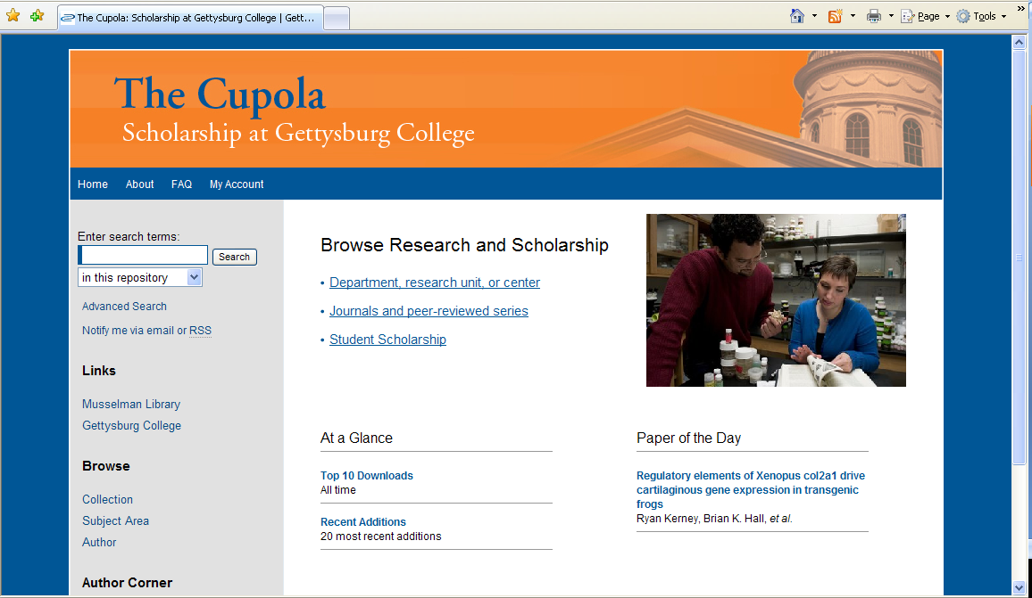
The Cupola: Scholarship at Gettysburg College
http://cupola.gettysburg.edu
Notes:
A product to customize and demonstrate – BePress became the Cupola
Policies about about submission and copyright

Slide 9
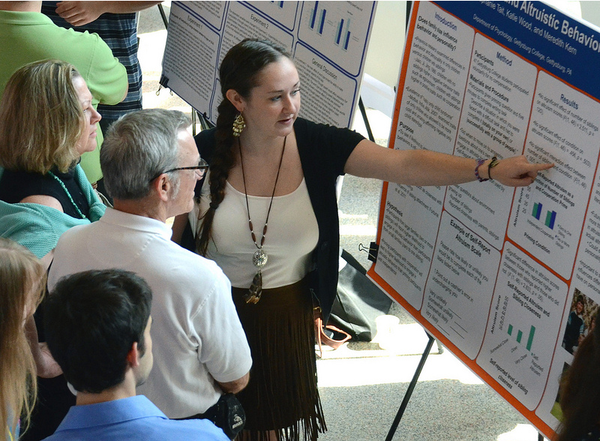
Content: student work
Why include student scholarship?
Beta submitters in Spring 2012
Plan A: Capture Celebration work
Plan B: Capture all, but publish only what faculty approve
Plan C: Faculty nominate the best work
Notes:
Not trying to archive every student work – just showcasing the best of undergraduate scholarship
4 beta students submitted content in a variety of formats – papers, slide presentations, posters
By the numbers May-August 2012:
42 nominations received from faculty in May 2012 – students invited to upload their work
14 actually uploaded content
A few more dribbled in, and some students were asked to revise and resubmit by the faculty reviewers
Today, 15 student works are published and we have 6 still in the review pipeline.

Slide 10
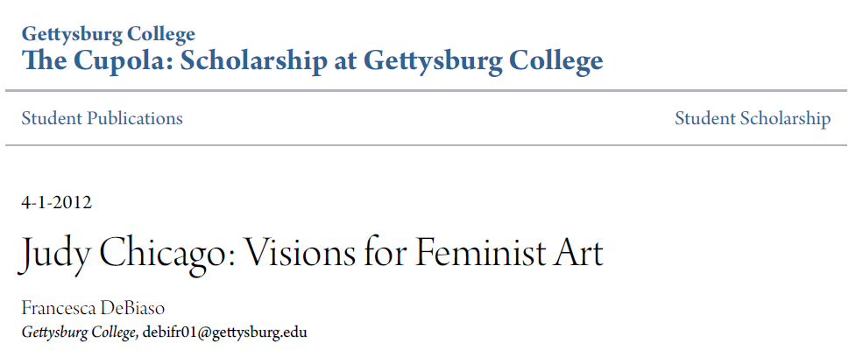
First posted 5/30/12
196 downloads as of 9/21/12
Notes:
This is our most downloaded item to date. Senior capstone project of art history student.

Slide 11
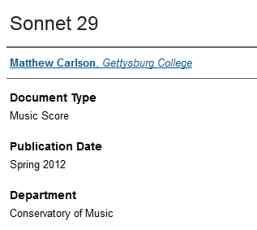
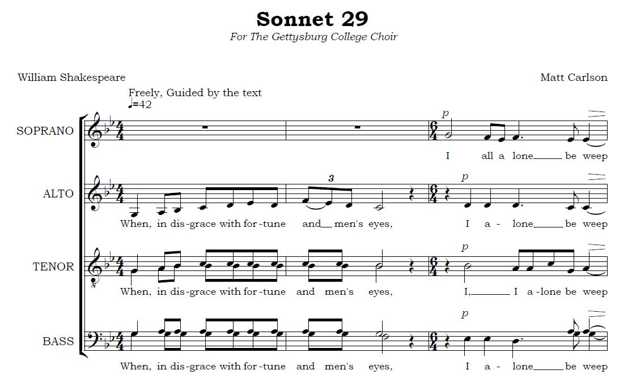
Notes:
The Cupola can also house non-text materials, including audio and video.
Of special note: original composition by music student (both score and sound recording uploaded).

Slide 12
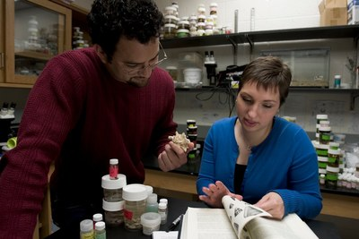
Challenges with student research
Timing
Copyright
Review of research involving animal or human subjects
Communication with students
Notes:
Timing – Our “Celebration” colloquium is the Saturday after classes end in the spring semester. Students go right into finals exams the next day, and then leave campus. NOT a great time to ask them to upload their work!
Copyright. Students have enough trouble understanding when copyright is an issue in their coursework. The rules can be a little different in the repository – what is acceptable to use and cite in an academic paper turned in for a class may require explicit copyright permission to reproduce in a publication. We created a “guidelines” document for students and included some detail about copyright in it (this document is on The Cupola site and viewable to the public). We also ask faculty to read this document when they nominate and review student work! We decided that while we would not post works with obvious copyright violations, nor would we go through submissions with a fine-toothed comb and act as enforcers of copyright law. EXAMPLE: the art history paper was uploaded without images because the student author couldn’t tell us where she got each image (probably a lot of copying from websites).
Human/animal subjects. On our campus, not all class research involving human or animal subjects requires review by the corresponding review boards. Students who assist faculty with their research or who perform individual research do go through the review process, but not all students who do research as part of a class do. We decided that we would NOT publish any student research that hadn’t undergone the appropriate review before the research was conducted. Period.
Graduating seniors retain their Gettysburg College email address for a month or so after graduation. They are instructed to set a forwarding address, but some don’t. We lost at least one student work because we lost touch with the student.

Slide 13
Content: faculty publications
Beta submitters in Summer 2012
Different set of copyright issues
Notes:
After publishing the first batch of student works in May 2012, we turned to faculty works. Each member of our committee identified one professor who could serve as a beta participant during the summer.
Copyright – we began by dealing with existing publications, so in most (but not all) cases the copyright had already passed from the author’s hands to a publisher. We needed to understand the self-archiving policies of the copyright holders. Start with SHERPA/RoMEO database and explore publisher websites as needed.
Some publishers allow IRs to publish only a pre-print or post-print rather than the final pdf (aka version of record)… and we discovered that most faculty authors don’t retain post-prints, which became a problem!

Slide 14
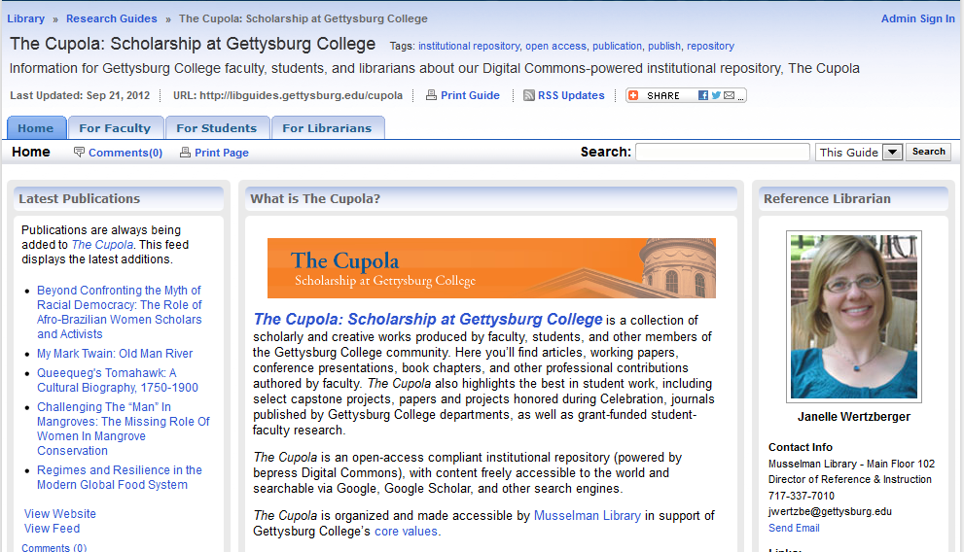
Marketing & outreach
Promotional materials
Individual outreach and “ambassadorship”
Group presentations
Make yourself much more satisfying!
libguides.gettysburg.edu/cupola
Notes:
Promotional materials
We created several pieces to support this work: a paper brochure (which is archived in The Cupola and publically accessible), a libguide with tabs for different audiences (faculty, students, librarians), and a slideshow presentation to take “on the road” (more about this later). We added links to several spots on the website – both on the library website and on the “faculty landing page” of the GC site. We tweet when publications are added. Other social media strategies: Facebook, blog…
Individual outreach and “ambassadorship” – We began informally educating faculty about the repository, starting with the beta submitters and expanding from there. We also met with all the professional librarians to do some “ambassador training” so that they could begin outreach.
Group presentations. The slideshow is titled “Open access publishing in Gettysburg College’s institutional repository” and we gave it to various groups beginning in September, 2012. We started with high level administrators (our Provost and everyone in his office; academic department chairs) and then began meeting with faculty during their departmental meetings.
… and right now we have 13 faculty publications published in The Cupola with many more in the pipeline as the word is spreading.

Slide 15
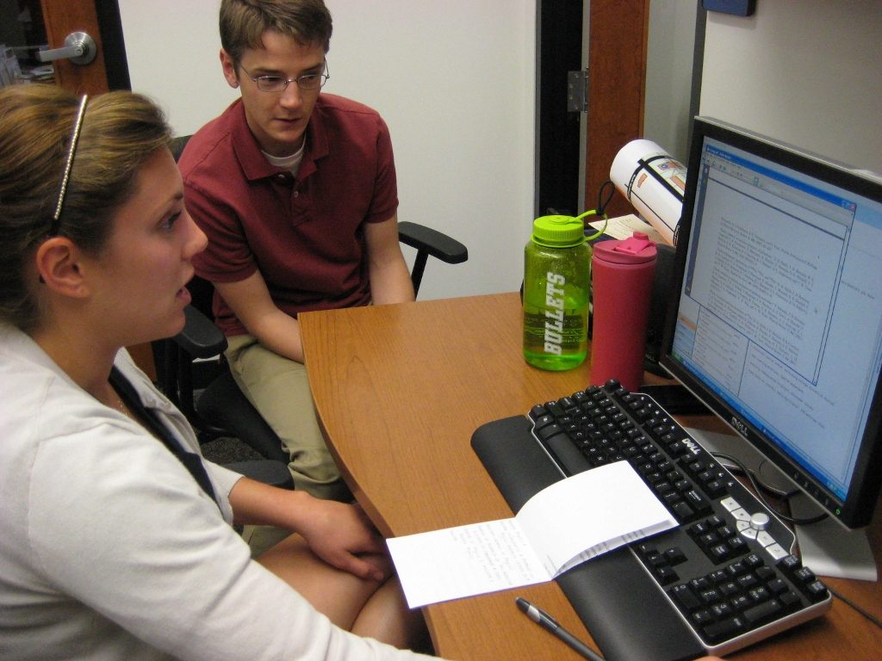
Scholarly Communication Assistant
Student employee
6 hours/week
Requires specific skill set
Notes:
With all of the successful marketing, we needed a student worker
Kate Reed: our Scholarly Communication Assistant
The submission process has a lot of stops and starts, and needs a dedicated follow-up person
Requires certain type of student

Slide 16
Position description
Assist librarians in soliciting and uploading content into Gettysburg College’s institutional repository (The Cupola: Scholarship at Gettysburg College). Learn how to identify publications that can be included in The Cupola. Investigate publisher policies regarding copyright and self-archiving. Assist in communicating with faculty authors and publishers as necessary (typically via email). Great opportunity for anyone interested in publishing, especially open access publishing in an academic environment. We will train the right student!
Essential Skills and Aptitudes: Self-motivated, acute attention to detail, proactive and adaptable, superb communication skills (particularly email), excellent student.
Notes:
Ad for the job
Kate started in September. She’s a senior history major and editor of history journal—which is one of the journals we’re hoping to use as a pilot for the journal platform (more on that in a minute)
One of the advantages of being at a small school!

Slide 17
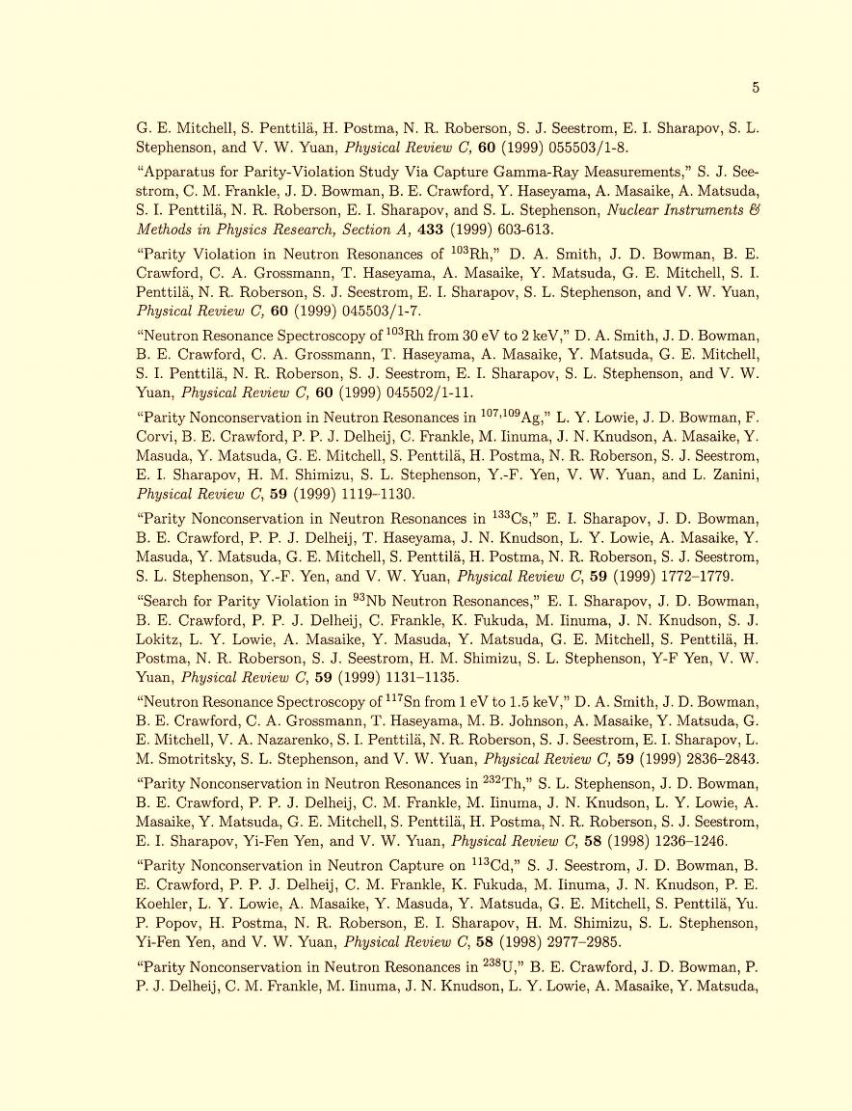
Faculty submission workflow
Receive Citations
2. Create folders
3. Clear copyright
4. Locate copy of works
5. Upload, quality control, post
Notes:
-So, our site is up, we have a student worker, and we’re talking to faculty – how do we actually get content into the Cupola??
-It pretty straightforward although it’s more chaotic in practice: juggling this workflow for an rapidly-increasing number of faculty, all of whom are at different stages in the workflow.
-Orange background = performed by librarians
-Blue background = performed by student
-Gray background = performed by both
Step 1: Receive citations
more informal, but we are proactively soliciting
We’re planning on receiving more through roadshow
Librarians to solicit from their liaison areas

Slide 18
Notes:
Step 2: Create folders
Modified from California Polytechnic workflow, which we found in the Digital Commons Collaboratory
We modified for digital record-keeping (Cal Poly using paper-based system)
Copy/drag Outlook emails into folders
Redundant but helpful; cumulative benefit--won’t have to spend as much time searching for policies

Slide 19
http://www.sherpa.ac.uk/romeo/search.php
Notes:
Step 3: Copyright clearance:
Ideally faculty would perform this, but in practice we have to
Sherpa-Romeo: database of publisher policies and permissions
Very helpful tool, an excellent starting point
Can’t rely solely on Sherpa-Romeo; pages often haven’t been updated in a few years
Confirm on publishers website
Determine copyright owner: “Published by Wiley-Blackwell”
Determine which version we can deposit and under what conditions: post-print, need permission and under a bunch of conditions
Request permission if necessary: in this instance, need to request permission

Slide 20
Permission to deposit
Notes:
Step 3 (con’t)
Email template for requesting permission
Step 4: Locate copies of works
Once we know which version we can deposit, locate those copies
Pre- and post-prints come from authors
Publisher’s version (aka version of record): databases, print collection, ILL

Slide 21
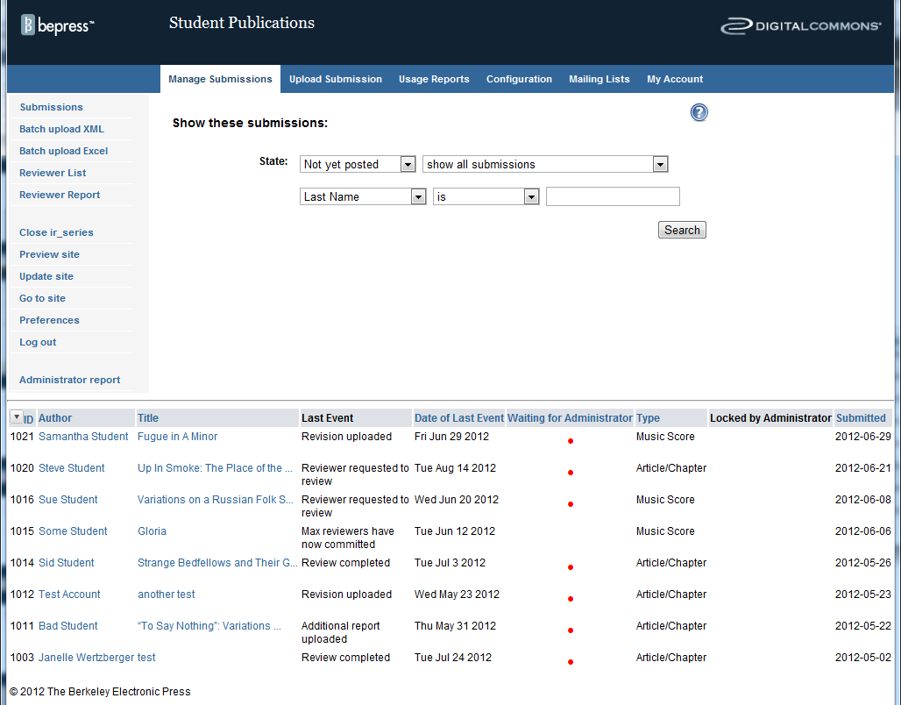
Notes:
Step 5: Upload
Digital Commons backend
Slight learning curve, mostly learning where things are located
There’s no access to underlying code (no programming experience required)
Red dots = require action
These works are stuck in the pipeline
There are reminder email templates built in that we can send from here

Slide 22
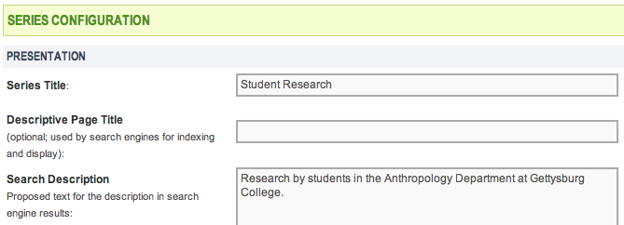
Student Research | Anthropology | Gettysburg College
cupola.gettysburg.edu/anthstu/
Research by students in the Anthropology Department at Gettysburg College.
Front End
Back End
Notes:
Screenshots to show how you can customize the back end and how that looks on the front end
“Student Research”: customize name of the collection
Green box: have control over the “snippet” that appears in Google
Red box: customize the URL schema (and you can get a sense of how our site is organized)
Digital Commons site organization
Community: top level building block; containers – no content in the community
Anthropology community contains “Faculty Publications” and “Student Publications” series
Series: where the content lives
“Faculty Publications” and “Student Publications” are both series within the Anthropology community
Also image galleries, books, journals, conference proceedings
Virtual collection: types of series, but no content inside – it’s a canned search
“Student Research” is a virtual collection
Displays the results of the search: items in student_scholarship and Department=Anthropology
All student work is in student_publications series: simplify upload process for students since there are many types of student works
Celebration, Mellon, regular old Student Research, etc.

Slide 23
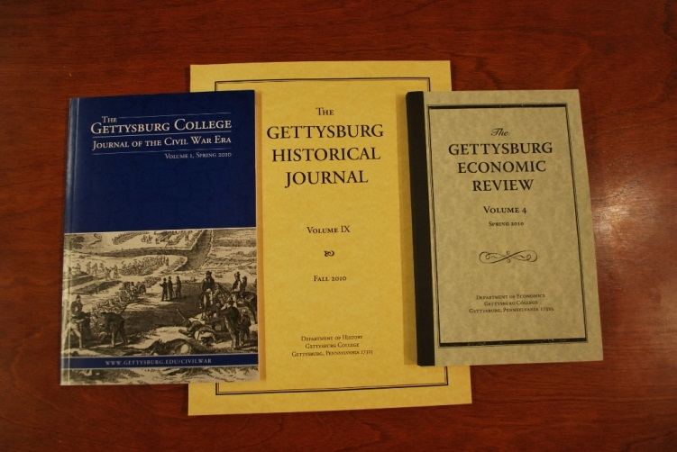
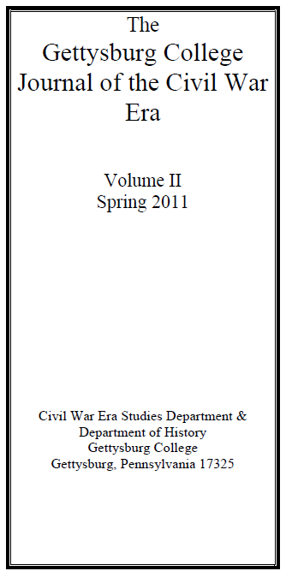
What’s next?
Journals
Faculty outreach
Cultivate relationships with potential content providers
Reporting
Notes:
Journals
Digital Commons journal platform: handle submissions, peer review, correspondence, all online
License includes 5 journals
Why publishing?
Further ties library to the College’s research mission
Deals with issues the library is already familiar with: open access, copyright, scholarly communication, research accessibility
Same benefits of IR: discoverability and visibility, authors retain right, permanent link to scholarship
Directions for Publishing
Surveyed campus to determine who publishes journals and identified two journals for pilot
One from the Civil War department and one from the History department
Faculty outreach
Provost’s meeting, Chair’s meeting, departmental meetings: roadshow, a la ACRL Scholarly Communications Roadshow
Potential content providers
Civil War Institute (20 student fellows), Eisenhower Institute
Reporting
DC reports along with Google Analytics
Snowball effect: reports sent to faculty will help us grow; “I had 100 downloads last month. How many did you have?”

Slide 24
Questions?
http://cupola.gettysburg.edu
This slideshow is archived in The Cupola, as is the trifold print brochure mentioned earlier.
http://libguides.gettysburg.edu/cupola
Email us: cupola@gettysburg.edu

