Slide 1
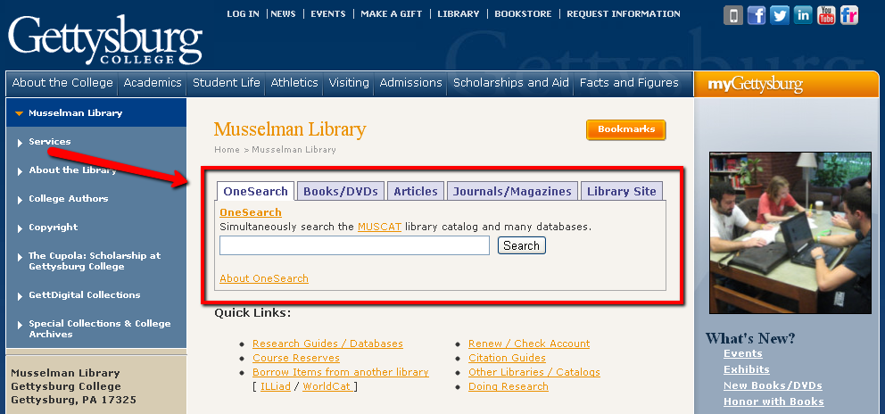
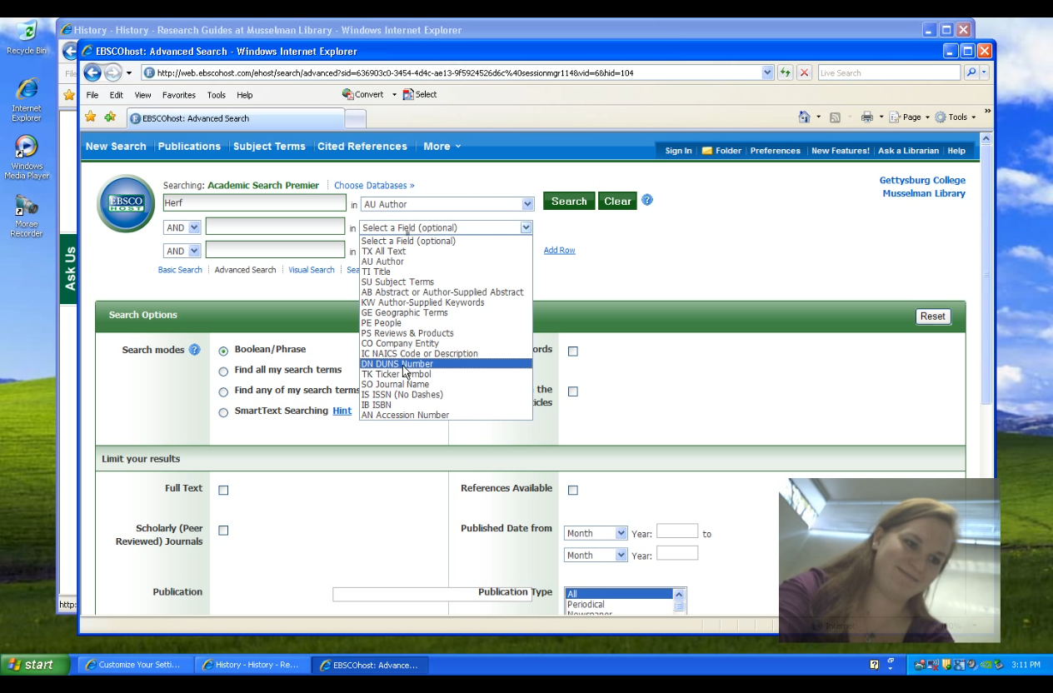
Understanding Discovery Evaluating the Use and Impact of EBSCO Discovery Service
Ronalee Ciocco, Director of User Services
Jessica Howard, Electronic Resources & Web Services Librarian
Donna Skekel, Serials & Electronic Resources Librarian
Implementation Timeline
Usability Testing
Fall 2010
Musselman Library acquired EBSCO Discovery Service, known locally as OneSearch.
Spring 2011
OneSearch launched.
Fall 2011
OneSearch search box added to first tab on library homepage.
Usability testing and survey conducted.
Spring 2012
Some sources removed from OneSearch.
Fall 2012
Federated search replaced with OneSearch subject-specific searches.
NOBODY LOOKS HERE! 7 of 8 test subjects missed seeing the EMAIL button in the upper right side of the title record.
None of the test subjects queried noticed the Integrated Search results on the right side of the search results page.
7 of 8 test subjects knew to use the limiters on the LEFT side of the search results screen.
Sometimes the test subjects did not immediately see the links to full-text.
Success: when test subjects used OneSearch to research and answer questions, they had better and faster results and were rated “3” or higher on a scale of 0-4. But, when not using OneSearch, ratings averaged 2.5 to 2.8 for the test subjects’ performance.
Prime Homepage Real Estate
Lessons Learned
Prominent location of the search box is important.
OneSearch detracted from the use of federated search.
OneSearch impacted ILL, but we customized contents to reduce this impact.
Periodic review of content additions is important.
Students like OneSearch.
Students appropriately used limiters, indicating a familiarity with the EBSCO interface.
The Integrated Search connectors in the right column are invisible to users.
Further analysis of impact on existing collections is needed.
We used Morae, a software and web user-experience testing product, for our recording and observation.

