Slide 1
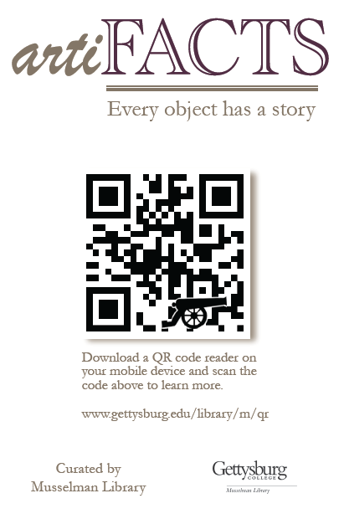
Making your mobile device an art expert: Using QR codes to tell the story behind artiFACTS in your library
Jessica Howard Electronic Resource & Web Services Librarian
Carolyn Sautter Director of Special Collections & College Archives
October 3, 2012
Pennsylvania Library Association Conference

Slide 2
Outline
Why artiFACTS?
Implementation
Marketing
Assessment

Slide 3
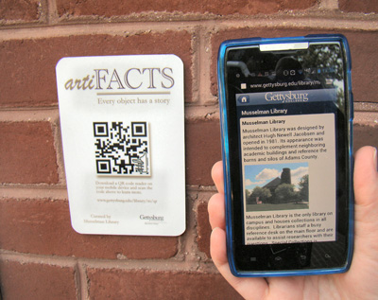
An art expert in the palm of your hand

Slide 4
Why artiFACTS?
Every object has the potential to tell a story.
Mobile devices can teach the history of an object.
Instant information can satisfy the natural curiosity of our library patrons and campus visitors.
Engaging technology revitalizes existing information.

Slide 5
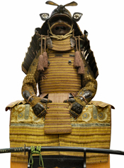
The process
Select the object
Research the object
Create the mobile page
Generate the QR code
Design, print, and post the sign

Slide 6
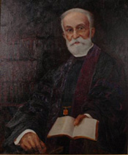
Select the object
Visibility of the object
Feasibility of location
Prior inquiries
Available information
Interesting content
Tie to College history
Aesthetic

Slide 7
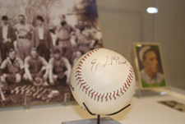
Research the object
Existing online sources
Physical research in Special Collections
“Investigative reporter” to track down the details
Fact checking

Slide 8
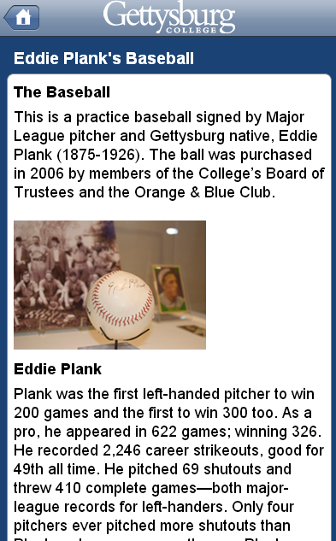
Breakdown of the mobile page
The object
The subject
Significance to the college
Additional links
Ask an Archivist
Suggest an artiFACT

Slide 9
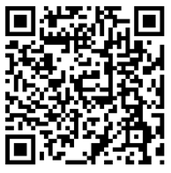
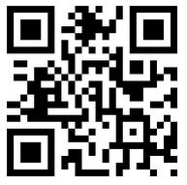
Generate the QR code
Shorten the URL
Google
Generate the code
Kayawa
K

Slide 10
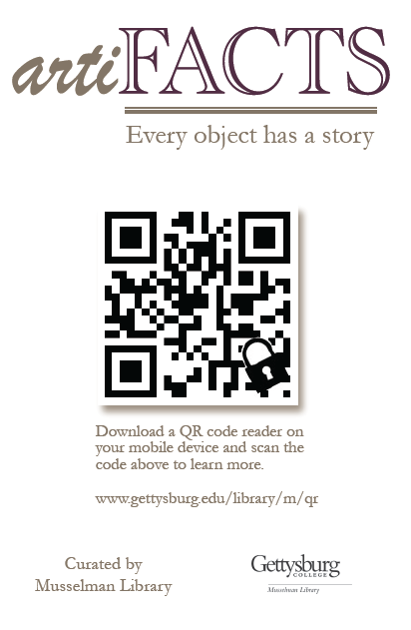
Design, print, and post the sign
QR whimsey
Sign template
Off-campus printing
All-weather material

Slide 11
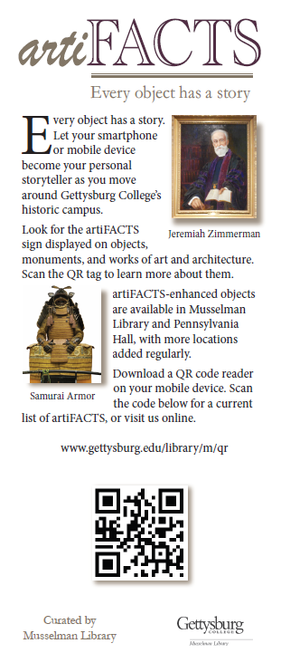
Marketing
Rack cards
Reference desk sign
Alumni/reunion weekend rollout
Student tour guides
Newsletter article
Email to faculty
Website

Slide 12
Assessment
Usage statistics
Codes = 154 scans
Pages = 570 unique page views
Anecdotal feedback

Slide 13
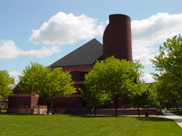
Next steps
Looking beyond Musselman Library
More objects
Additional marketing and assessment
Map of artiFACTS locations

Slide 14
Thank you
Jessica Howard jhoward@gettysburg.edu
Carolyn Sautter csautter@gettysburg.edu

