Slide 1
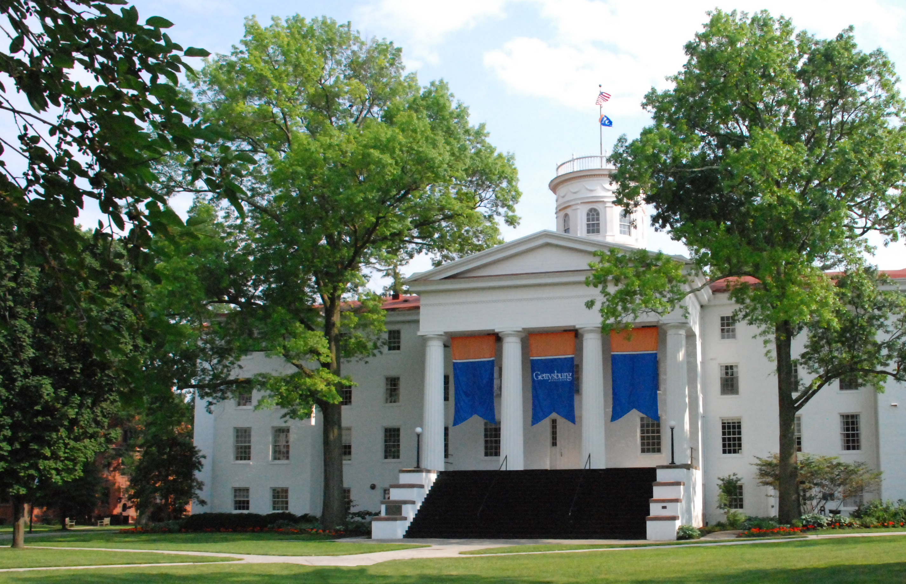
From climate change to vaccination safety: Teaching information literacy in an undergraduate epidemiology course
Amy Dailey, PhD, MPH
Meggan Smith, MLIS

Slide 2
Presenter Disclosures
Amy Dailey and Meggan Smith
(1) The following personal financial relationships with commercial interests relevant to this presentation existed during the past 12 months:
No relationships to disclose

Slide 3
Fake news and alternative facts
Role as educators in our current climate of “fake news,” “alternative facts,” and war higher education
Teaching information literacy (IL) is essential if we expect students to become well-informed citizens prepared to navigate today’s digital landscape, political climate and 24-hour cable news cycle
One of my goals as a public health educator:
To make IL outcomes a much more intentional focus of my courses

Slide 4
Methods
Undergraduate Epidemiology course with lab
Worked with a research and instruction librarian to identify IL outcomes and develop assignments that would address those outcomes
Developed and tested a rubric to assess IL outcomes at the course-level
Randomly chose 5 student assignments from 6 journal/media assignments for assessment

Slide 5
From Standards to Framework
The Association of College and Research Libraries (ACRL)
Information Literacy Competency Standards for Higher Education (2000)
Framework for Information Literacy for Higher Education (filed by ACRL 2015; adopted by ACRL 2016).
Musselman Library, Gettysburg College
Information Literacy Student Learning Goals (March 2017)
Scholarship as Conversation
Research as Inquiry
Authority is Constructed and Contextual
Information Creation as a Process
Information Has Value

Slide 6
Student Learning Outcomes
Authority is Constructed and Contextual
Students should be able to:
1) Examine and compare information from various sources in order to evaluate accuracy, authority, currency, and point of view;
2) Recognize the cultural, physical, or other context within which information is created and how that context impacts interpretation;
3) Investigate differing viewpoints encountered and determine whether or not to incorporate or reject these ideas;
4) Develop a self-awareness of personal bias and worldview and understand how that influences information interpretation

Slide 7
Student Learning Outcomes
Research as Inquiry
Students should be able to:
5) Evaluate information and explore multiple perspectives while maintaining an open mind and critical stance.
Scholarship as Conversation
Students should be able to:
6) Recognize that information may be perceived differently based on the format in which it is presented;
7) Recognize that participation in a scholarly conversation is impacted by power and authority structures, prioritizing certain voices and perspectives.

Slide 8
Assignments
video diary; screencast-o-matic.com
Objective: Understand how students search for science/health/political information at baseline under casual circumstances.
Students audio- and video-recorded their process for searching for reputable information on climate change and health
Not graded, but professor watched videos and took note of themes
Notes:
Scenario: Over break your extended family all met up for dinner at your house to celebrate a holiday. After dessert your family got into a heated argument about climate change and health. Knowing that you are a Gettysburg College student getting a liberal arts education, your family members ask you for your opinion. Not feeling comfortable speaking on demand, you ask to be excused and you sneak off to a private room to do a quick online search. You're looking for a reputable article or two to bring back to the discussion.

Slide 9
Themes
Reliance on first few links on google
Non-specific search terms
Some students took a very academic approach. Unclear if what they are learning in the classroom is translating to everyday research skills
Skepticism about quality of information put out by “the government” since election
Vastly different interpretations of what was relevant. Challenged my assumptions of what they would choose.
Some students chose very specific primary research articles– got into the weeds and didn’t know how to get out
Assumptions about everything on Google Scholar being high quality

Slide 10
IL Assignments
Baseline video research diary
Assessing popular media articles about peer-reviewed scientific literature
Vaccines and Autism: Examining source type, audience, agendas and personal position
Climate change and health: Examining source authority
Scientific authority: Asking an author
Integrating epidemiologic assessment with assessing popular media presentation of scientific information
See handout

Slide 11
Rubric Development
After the course was finished, we developed a rubric to evaluate whether the course-level IL outcomes were achieved
We used themes from the Screencast-O-Matic video diary and the College Library IL outcomes to inform different levels of proficiency on the rubric (see handout)
Tested the rubric with a sampling of each of the assignments
Refined the rubric to:
Include 2 IL outcomes we did not previously intend to focus on
Distinguish between emerging, developing, and proficient levels

Slide 12
Did student IL improve?
Students largely achieved “proficient” status for the following items:
Demonstrating differences between source types and authority
Distinguishing between formats of presentations and how that impacts messages
Incorporating critical analysis of multiple perspectives
Students largely achieved “developing” status for:
Acknowledging potential agendas/biases of sources
Difficulty with identifying agendas/bias in “science”– automatic trust in sources they deemed “scientific”
BUT, also overly-dismissive of scientific articles after learning about epidemiologic biases and confounding
Difficulty with identifying what makes a news article credible

Slide 13
Did student IL improve?
“Emerging:” Students struggled with recognizing differentials in power and authority structures and the cultural contexts within in which information is created and interpreted
Lesson Learned: I need to be more intentional with my questions to get students to analyze these particular issues
These topics were often the focus of class discussions– not reflected in course rubric
See discussion rubric provided in handouts
Confusion around “open access”
Students often acknowledged own emotions when reading particular arguments, but stopped short of thinking about how their own position, education, etc. influenced their interpretation

Slide 14
Did student IL improve?
Some of the IL outcomes we set out to achieve were not adequately addressed in the assignments
Lesson Learned: It is really important we constantly revisit our intended student learning outcomes and make sure that our assessments are measuring those outcomes

Slide 15
Moving Forward
If we are concerned about our current information climate, we should all be thinking about how we integrate IL outcomes into our classes.
Question assumptions about student IL learning in other classes or on their own and prioritize IL in public health coursework.
Collaboration with librarians is critical to teaching students IL, institutionalizing IL on our campuses, and sustaining enthusiasm for this work.

Slide 16
References
Association of College & Research Libraries. Framework for Information Literacy for Higher Education. Chicago: Association of College & Research Libraries; 2015. http://www.ala.org/acrl/standards/ilframework. Accessed October 30, 2017.
Association of College & Research Libraries. Information Literacy Competency Standards for Higher Education. Chicago: Association of College & Research Libraries; 2000. http://www.ala.org/acrl/sites/ala.org.acrl/files/content/standards/standards.pdf. Accessed October 30, 2017.
Musselman Library, Gettysburg College. Information Literacy Student Learning Goals. http://www.gettysburg.edu/library/information/departments/reference/instruction/Gettysburg%20IL%20goals%20March%202017.pdf. Published March 2017. Accessed October 30, 2017.

