Slide 1
Open Access, Social Justice, and the Moral Imperative: Why OA Publishing Matters to WGS
Sarah Appedu ’18 | She/hers/her | Scholarly Communications Assistant
Presented for WGS 300 | Fall 2018
Notes:
Hi everyone. My name is Sarah Appedu, my pronouns are she/hers/her, and I work in the Scholarly Communications department of Musselman Library. I also graduated from Gettysburg last year with a major in Philosophy and minors in Theatre Arts and WGS, and today I am here to talk to you about how my work in the library has intersected with my passion for WGS and social justice.
The title of my presentation is “Open Access, Social Justice, and the Moral Imperative: Why OA Publishing Matters to WGS”. This week is International Open Access Week, so the timing of this presentation is perfect.
Before we begin, I’d like to start with some questions.
Who here is a WGS major or minor?
Who here has heard of The Cupola? Can you tell me what you think it is? Who has work in there already?
Has anyone heard of Open Access? What do you think it means?
If you did not know the answers to those last two questions, you will shortly.

Slide 2
Learning Outcomes
Define Scholarly Communications as a department and as a network in order to contextualize your work within the larger system of academic publishing.
Articulate how Open Access is one response to the inequality implicit in traditional academic publishing in order to apply the concept of information privilege to your own lives and practices.
Relate the values of WGS to the goals of Open Access in order to see the relationship between Open Access and other social justice movements studied and championed by WGS as a discipline.
Notes:
The following is what I would like you to take away from this presentation. (read slide)
I also welcome you to stop by and ask questions throughout this presentation.

Slide 3
Introduction to Scholarly Communications at Gettysburg
Our Team:
Janelle Wertzberger, Assistant Dean and Director of Scholarly Communications
Chris Barnes: Scholarly Communications Librarian
Sarah Appedu: Scholarly Communications Assistant
We maintain The Cupola, assist with contract negotiation, and are committed to Open Access and Open Education
Notes:
First off, I’d like to introduce you to our department.
Some of you already mentioned that you know what the Cupola is, so you’re familiar with our department even if you have never heard of Scholarly Communications in your life.
We are made up of three people (names), and deal primarily with maintaining The Cupola, our open access institutional repository where we host faculty and student work, assisting faculty with contract negotiation, and are committed to furthering movements such as Open Access and Open education. Open Access will be addressed throughout this presentation, and Open Education is a separate but related movement dealing more specifically with the cost of textbooks and learning materials.
I have learned a lot about Open Access since taking this position this summer, and it has become clear to me that Open Access is a social justice movement, which I am proud to be a part of. Today, I would like to demonstrate the following: (next slide)

Slide 4
The principles and values championed by WGS are compatible with and necessary to the success of Open Access.
AND
The principles and values championed by Open Access are compatible with and necessary to WGS as a discipline.
Notes:
In order to prove these points, we need to ask a couple of questions:
What are the values of WGS?
What is Open Access, and what are its values?
And finally, what is the relationship between the two?

Slide 5
What are the values of WGS as an academic enterprise?
Notes:
The first question we should ask is: What are the values of WGS?
Let’s start by brainstorming some values that you feel are relevant to WGS. You will work with someone next to you and try to come up with two or three values that you feel are essential to WGS as an academic enterprise. When you are done, write them on separate post its and hand them up so we can discuss.
It may be helpful to draw on specific readings you have done this semester to find the answer. For example, the concept of intersectionality might reveal that WGS values identity. Try picking a reading that has been particularly interesting to you and using it to flesh out some potential values. What you’re really asking is what matters to yourself as a WGS major/minor and to the discipline as a whole. We’ll reconvene in about five minutes.
Once the class sends up their post its and their words are written on the board, ask for some reflections.
What words were common among you and your partner? Which were different?
Why did you pick the words they did?
What themes emerge from these words?

Slide 6
What is Open Access, and what are its values?
Notes:
Our second question is, “What is Open Access?”
To start, Open Access is a response to a failing system, but we must understand the problem before we can answer the question of the solution.
I’m going to pause here to give you an assignment to do throughout the presentation. I will be discussing Scholarly Communications and Open Access, and at the beginning I claimed that these values were important to WGS as a discipline. As I’m speaking, try to pick up on potential values that reveal themselves as I explain these concepts. At the end, I’m hoping you will all have a few written down on the remainder of your post its for us to discuss at the end.

Slide 7
“The Scholarly Communication system incorporates and expands on the more familiar concept of scholarly publishing, and includes both informal and formal networks used by scholars to develop ideas, exchange information, build and mine data, certify research, publish findings, disseminate results, and preserve outputs. This vast and changing system is central to the academic enterprise, which makes it central to the work of academic librarians.”
-10 Things You Should Know About Scholarly Communications
Notes:
That broken system that I mentioned is what we call Scholarly Communications. You have already seen what it looks like as a library department, but the Scholarly Communications system has been around as long as scholars have been writing and sharing research.
Here is one definition of Scholarly Communications: (read slide)
Ask students to summarize this definition in their own words.
Where do you see Scholarly Communications taking place in your own lives? You are scholars and participate in scholarship everyday, which positions you within this system.
While Scholarly Communications library departments are fairly new, this network has existed since the scholars first started formally sharing their research in the 1600s.
The values of the department when seen in this way really come down to the sharing process. So what does that process look like?

Slide 8
The Narrative of the Scholarly Article
Who did the majority of the work in this process?
Who owns the work?
How much of the article’s revenue will each participant (author(s), reviewer(s), publisher) get paid?
Notes:
Let me tell you the story of an academic article from its conception to its dissemination.
It all starts with the researcher. This researcher is usually a faculty member is who paid a salary by their institution, and an output of research is considered part of the job and is necessary to securing tenure. The money for this salary comes from tax dollars if it is a publically funded institution, or tuition dollars if it is a private institution like Gettysburg.
The researcher writes up a draft of their findings. Next is peer review, which is done by an anonymous community of colleagues in the field who determine whether the topic is new, innovative, comprehensive, and suggest potential edits.
Once the author makes some changes, they submit the article to the publishing company, who will more than likely ask them to sign a contract relinquishing their copyright of the work to the publishing company with the justification that this is necessary to ensure their work has the largest impact. High impact means more citations, more attention, and more prestige.
Then, the publisher does their part, formatting the content to look like a typical journal article, bundling this work up into a journal and charging libraries thousands of dollars to subscribe to those journals (because of increasing impact, right?). This dissemination used to happen primarily through print and profits were used to cover production costs. Today, these articles are primarily posted and accessed online. (Ask questions on slide)
The answer to that last question is that the publisher will actually receive…. (next slide)

Slide 9
100%
Notes:
…of the profits. The size of this font lets you know that this is a big deal. The fact is that neither the author nor reviewer will see a cent of the money made off of their work. Because they are compensated in prestige, and because they give their copyright to the publisher, the for-profit publishing companies are able to made huge amounts of profit without having to spend much money on the end product.
But this isn’t the only way they make a profit.

Slide 10
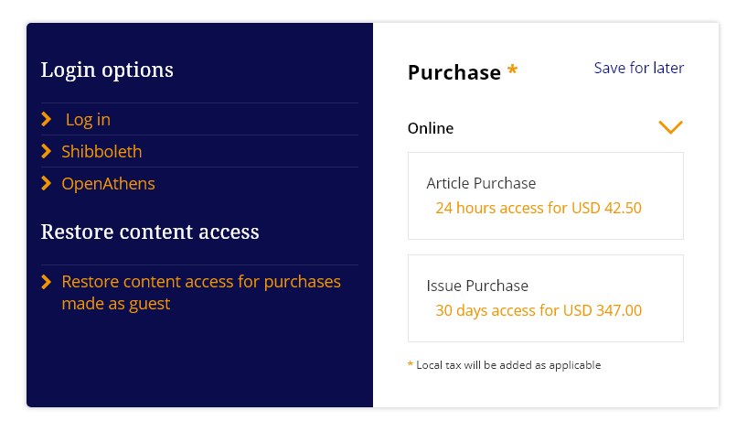
Notes:
This is what we call a “Paywall”. Have any of you ever encountered one of these before? If so, what did you do?
This is actually a screenshot of the paywall in front of the article “I Am Your Sister: Black Women Organizing Across Sexualities” by Audre Lorde, published by Taylor & Francis (one of the topic 5 academic publishers in the world), which I know is on your syllabus.
You might hit this as a university if your school does not subscribe to the journal, which is one way they make a revenue. If you do not belong to a subscribing institution, you are faced with a la carte style access, paying for the individual article you might need. You might not see these much now while you’re at Gettysburg, but once you graduate and your institutional access expires, this will become much more normal.
So…

Slide 11
Why are publishers charging $50 for one-time, 24 hour use of an article that they did not write, did not fund, did not hire or pay the faculty member for, and did not use any materials to print?
Notes:
(Read question) They claim they need an authors copyright so that the article can have the largest impact. They claim these policies are not in the name of profits, but the internet now allows us to disseminate work with almost no production cost on a platform that’s accessible around the world, but the model for publishing did not change. In fact, profit margins for publishing companies such as Elsevier are at an all time high of around 37%.
In comparison, Google’s is ~13%,Walmart’s is ~25, and Amazon is ~4%. And these profits are a direct result of artificially restricting access to only those who can pay the toll.
There are many consequences to this antiquated system: it slows down the research process, it limits participation in the scholarly conversation to only those who can afford to do so, which reinforces the elitist division between the traditionally education and those who aren’t, can lead to life or death situations when doctors cannot afford to read the most up-to-date medical knowledge in their field, and undermines the promise of a free and equal internet.
There are also epistemic consequences. This system restricts not only who can access information, but who can create it and what “counts” as scholarship. Scholarship must recognize the value of all perspectives and voices and must encourage a diversity of mediums for articulating these perspectives, encouraging researchers to move beyond the scholarly monograph as their only source for information. I know you guys have studied epistemology in this class and how knowledge creation can be used to either enforce or undermine systems of power. Publishing in this way often makes one complicit in a system that privileges the academic elite as the only community worth reading or writing scholarship, and therefore worthy of writing our notions of truth, our worldviews, our fundamental principles- and the publishers act as if you have no other choice.
So is it really impact publishers are concerned with? How can that be true when their publishing model relies on unequal access to information, on restricting knowledge based on the amount of money in one’s bank account, and on limiting the types of perspectives that are welcomed?

Slide 12
OA as a response to inequality
Open Access has many definitions:
“Open-access (OA) literature is digital, online, free of charge, and free of most copyright and licensing restrictions”-Peter Suber.
Goal: To create equal access to read, participate in, and create scholarship regardless of where you live, what institution you are apart of, if any, and how much money you have.
Notes:
Open Access and Scholarly Communications departments in libraries are a response to this failing system in order to reorient it around the values of impact, inclusion, and equity (as opposed to profit). (read slide)
Open Access publishers find new models for supporting their work that do not rely on reader-facing fees, which we will take a look at in a few moments.
Also, the value of the internet is that it makes it much easier to get ones’ voice heard and can be used as a tool to highlight historically marginalized voices in a way traditional journals often reject because of their deviance from the status quo; i.e., from traditional frameworks of knowledge and power that privilege certain ideas of points of view over others.

Slide 13
Open Access in Practice
Open Access journals
Made with Creative Commons
Ebola outbreak control
Institutional Repositories and author rights
Notes:
Here is what these ideas look like in practice. Open Access journals have found many ways to fund their work that does not require a subscription fee, thereby defying the standard set by neoliberal capitalism that education is a commodity you must purchase rather than a public good all are entitled to.
Made with Creative Commons is one organization spreading the word about open publishing using a CC license, which is a new way to use copyright in a way that preserves an author’s ownership of the original work, while also signaling to the world that this work is free and open to read, reuse, and build upon.
Cards Against Humanity example
The Ebola outbreak could have been curbed sooner if an article warning of a potential epidemic had not been published closed, but the research being done at the time of the outbreak was published open which allowed a solution to be found much more easily.
Finally, institutional repositories provide a free way for authors to disseminate their work, and we provide authors with resources as to how to negotiate with publishers to retain enough of their copyright to post on The Cupola without an embargo period. This is a major way that our departments increases the amount of open scholarship on the internet.
Clearly, there are values at stake here that are considered more important than profit- life and health being just a couple.

Slide 14
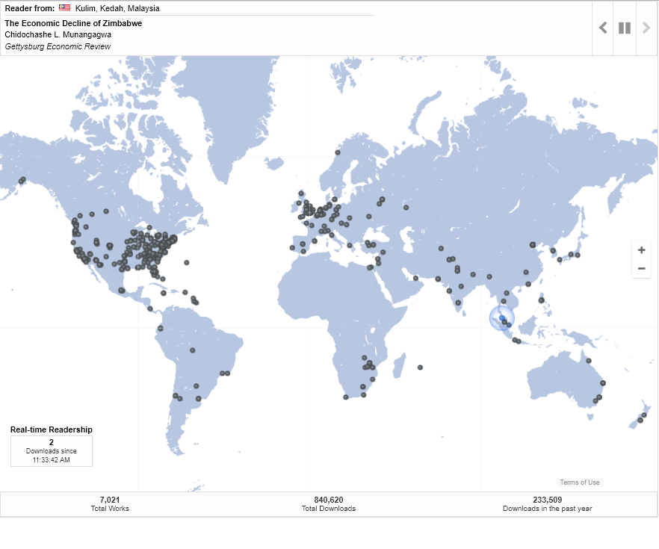
Data as of 10/25/18

Slide 15
Group Activity
Break off into small groups of 2-3
Look at your syllabus and choose one reading
Search the title of the article (in quotations)
What kind of access are you experiencing? Where can these articles be read? Are there open versions posted somewhere?
Notes:
The point of this activity is to explore different types of access you may come across when trying to read these works without an institutional log in.

Slide 16
“[D]emocracy intersects with intellectual freedom, as people need social, political, and physical agency to acquire knowledge in order to be able to engage meaningfully in the democratic process. In a related way, democracy intersects with the values of education and lifelong learning. Individuals must have access (another core value) to education and educational content in order to exercise intellectual freedom and engage in the self-determination of democracy.
-April Hathcock, “Racing to the Crossroads of Scholarly Communication and Democracy: But Who Are We Leaving Behind?”
Notes:
Now that you understand more about Open Access, we can return to the question of values. Scholarly Communications as a system is engaging in a critical analysis of its systems, which operates on unequal access to knowledge for the sake of profit. While librarians are not at the heart of the publishing process itself, we are in a unique positon to question the system and encourage practices that more closely align with our values. I would argue you too are in a similarly unique positions as students of WGS, a discipline that is founded on the need to critically engage with the systems around us to make a more inclusive world.
Here, April Hathcock, a Scholarly Communications librarian at NYU who is well known for her critical engagement with the movement, discusses the intersection between Scholarly Communications and democracy, and she highlights some of these values. (read quote)
I’d now like to take your post its that you made throughout this lecture and put them on the board.
Let’s look at what we have. What are the similarities? What are the differences? In what ways do these fields seem to overlap?
This is about privilege: informational, racial, geographical, class, etc. Regardless of how we all got here, we all are privileged to be able to say that we got a Gettysburg education, where we had access to resources that many others, even just outside our little community, could not afford. Recognizing this privilege reveals the role Scholarly Communications plays in creating a more equal and just society, as well as the role each of us in this room plays with the decisions we make in regards to how we consume and share knowledge.
Here is where the intersection comes to life for me personally. While learning about the Open access movement, it has become clear to me that Scholarly communications is one avenue through which I can help others experience that same empowerment that I felt when studying WGS who may not have had the opportunities I did. I know my studies here in this discipline enlightened me to a new way to see the world, which made the feelings of marginalization I felt personally and the ones I heard about from others make sense, and made it clear that there was something to be done about it. It has also made me aware of the information privilege that I have and the need to spread this awareness to students like you, who are posed to take up critical positions and are often interested in ways you can undermine frameworks of power.
As a first generation college student, I grew up having heard my parents talk about the opportunities I would have that they never did, but I took for granted just what it meant. It wasn’t until I was in the throws of my studies, becoming aware and empowered in a way that I had never imagined, that I realized what they meant. Not only do I have the ability to get higher paying jobs than my parents, but I can navigate the world with an ease that they have not been afforded. I know they have felt shame at their lack of education, and when I talk to them about what I learn in school they often preface their responses with a warning that they aren’t “qualified” to have opinions. And to be able to work in a department that ensures people like my parents, who did not have the money to invest in an education, could feel like they are equally deserving of participating in this world, makes me very proud.

Slide 17
The principles and values championed by WGS are compatible with and necessary to the success of Open Access.
AND
The principles and values championed by Open Access are compatible with and necessary to WGS as a discipline.
Notes:
And now we’re back at the premises I started off with. I have hopefully demonstrated to you how WGS as a discipline of critical and socially engaged thinkers is well equipped to dismantle systems of power, making them strong allies to the OA movement. Students in the discipline of Women, Gender, and Sexuality Studies are positioned to critically engage with systems of power and apply academic theory to real world practice as a field that has a clear and implicit social justice angle to its scholarship.
But I hope you can also see how Open Access publishing is a necessary tool to subverting and dismantling systems of power as well, and when you are writing about marginalization and power, this is one way to practice what you teach. This is the moral imperative.

Slide 18
How YOU can participate now
Take an Open Access pledge
Publish in The Cupola
Including our 5 Open Access undergraduate research journals
Donate to organizations that support OA publishing
Join student peers to advocate for the creation of a Gettysburg OA mandate
Stay informed

Slide 19
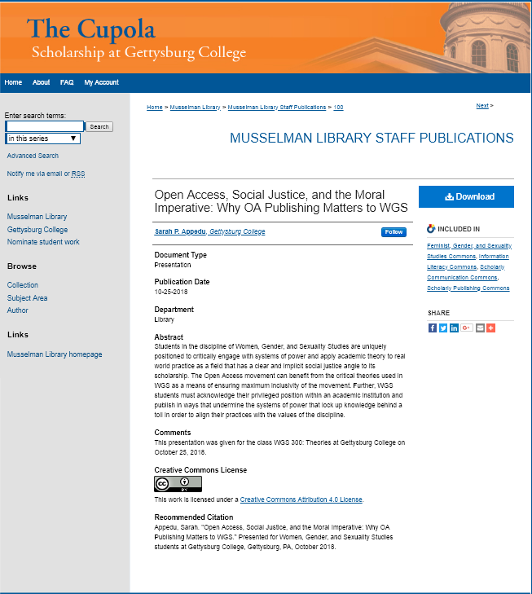
Notes:
This presentation is an example of how I personally am participating in this. I will be uploaded it to The Cupola, and while it is not a traditional publication and does not exist in a closed version online, I will be using a Creative Commons Attribution license, the most liberal licensing option. I am also sending the message that scholarship takes many forms beyond the traditional scholarly monograph and that these types of sources are valuable to the research process as well.

Slide 20
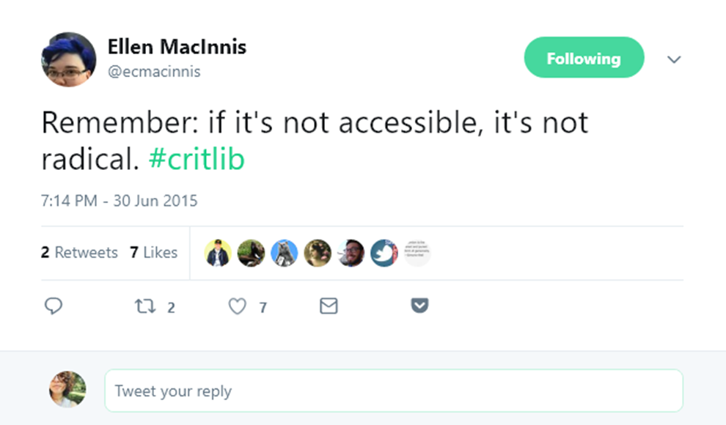
Notes:
I wanted to end with this tweet by a woman named Ellen MacInnis, a children’s librarian for the New York Public Library. The hashtag #critlib refers to critical librarianship, which is really what I am doing with you today. It takes a critical look at library systems and practices to make them more inclusive. Here she was specifically referring to the language we write our scholarship in, which is relevant as well (think Judith Butler here). But I think the message applies to literal access as well.
Why are we doing the work we do? What matters to us (we’ve already started to answer this)? What changes do we want to see in the world? How can do make these changes happen?

Slide 21
Further Reading
“Giving it Away”, Kathleen Fitzpatrick
“RACING TO THE CROSSROADS OF SCHOLARLY COMMUNICATION AND DEMOCRACY: BUT WHO ARE WE LEAVING BEHIND?”, April Hathcock
“Scholarly Communication in a Time of Change: Considering the Impact of Bias, Diversity, and Traditional Publishing Structures as Scholarly Communication Moves to New Platforms and Systems”, Charlotte Roh
“Diversity, Equity and Inclusion in Open Research and Education”, Tara Robertson
“Paywall: The Business of Scholarship” (film), Jason Schmitt
Notes:
Here are some further resources if you are interested in reading more, and I have linked them all so they are easy to access. These sources are all openly available.

Slide 22
Bibliography
“Alphabet Profit Margin 2006-2018.” Data complied by Macrotrends LLC. June 30, 2018. https://www.macrotrends.net/stocks/charts/GOOG/alphabet/profit-margins
“Amazon Profit Margin 2006-2018.” Data complied by Macrotrends LLC. June 30, 2018. https://www.macrotrends.net/stocks/charts/AMZN/amazon/profit-margins
Dahn, Bernice, Vera Mussah, and Cameron Nutt. “Yes, We Were Warned About Ebola.” The New York Times (New York, NY), April 7, 2015. https://www.nytimes.com/2015/04/08/opinion/yes-we-were-warned-about- ebola.html?_r=0
Eisen, Michael. “The Past, Present, and Future of Scholarly Publishing.” Published March 28, 2013. http://www.michaeleisen.org/blog/?p=1346
Notes:
And lastly, my bibliography, which you will note also has links to all sources, which are all openly available.
Thank you so much for listening and happy Open Access week!

Slide 23
Bibliography cont.
Hathcock, April. “Racing to the Crossroads of Scholarly Communication and Democracy: But Who Are We Leaving Behind?” Posted August 22, 2018. http://www.inthelibrarywiththeleadpipe.org/2018/racing-to-the-crossroads-of- scholarly-communication-and-democracy-but-who-are-we-leaving-behind/
Keener, Molly, Joy Kirchner, Sarah Shreeves, and Lee Van Orsdel. “10 Things You Should Know About… Scholarly Communication.” Originally created for the ACRL 14th National Conference, Scholarly Communication 101 Workshop, 2009. http://digitalcommons.unl.edu/scholcom/47/
Suber, Peter. “Open Access Overview” last modified December 5, 2015. https://legacy.earlham.edu/~peters/fos/overview.htm
Stacey, Paul and Sarah Hinchliff Pearson. Made With Creative Commons. Copenhagen: Crlt+Alt+Delete Books, 2017. https://creativecommons.org/wp- content/uploads/2017/04/made-with-cc.pdf
“Walmart Inc Gross Profit Margin (Quarterly)”. Data complied by Ycharts. July 31, 2018. https://ycharts.com/companies/WMT/gross_profit_margin

