Slide 1
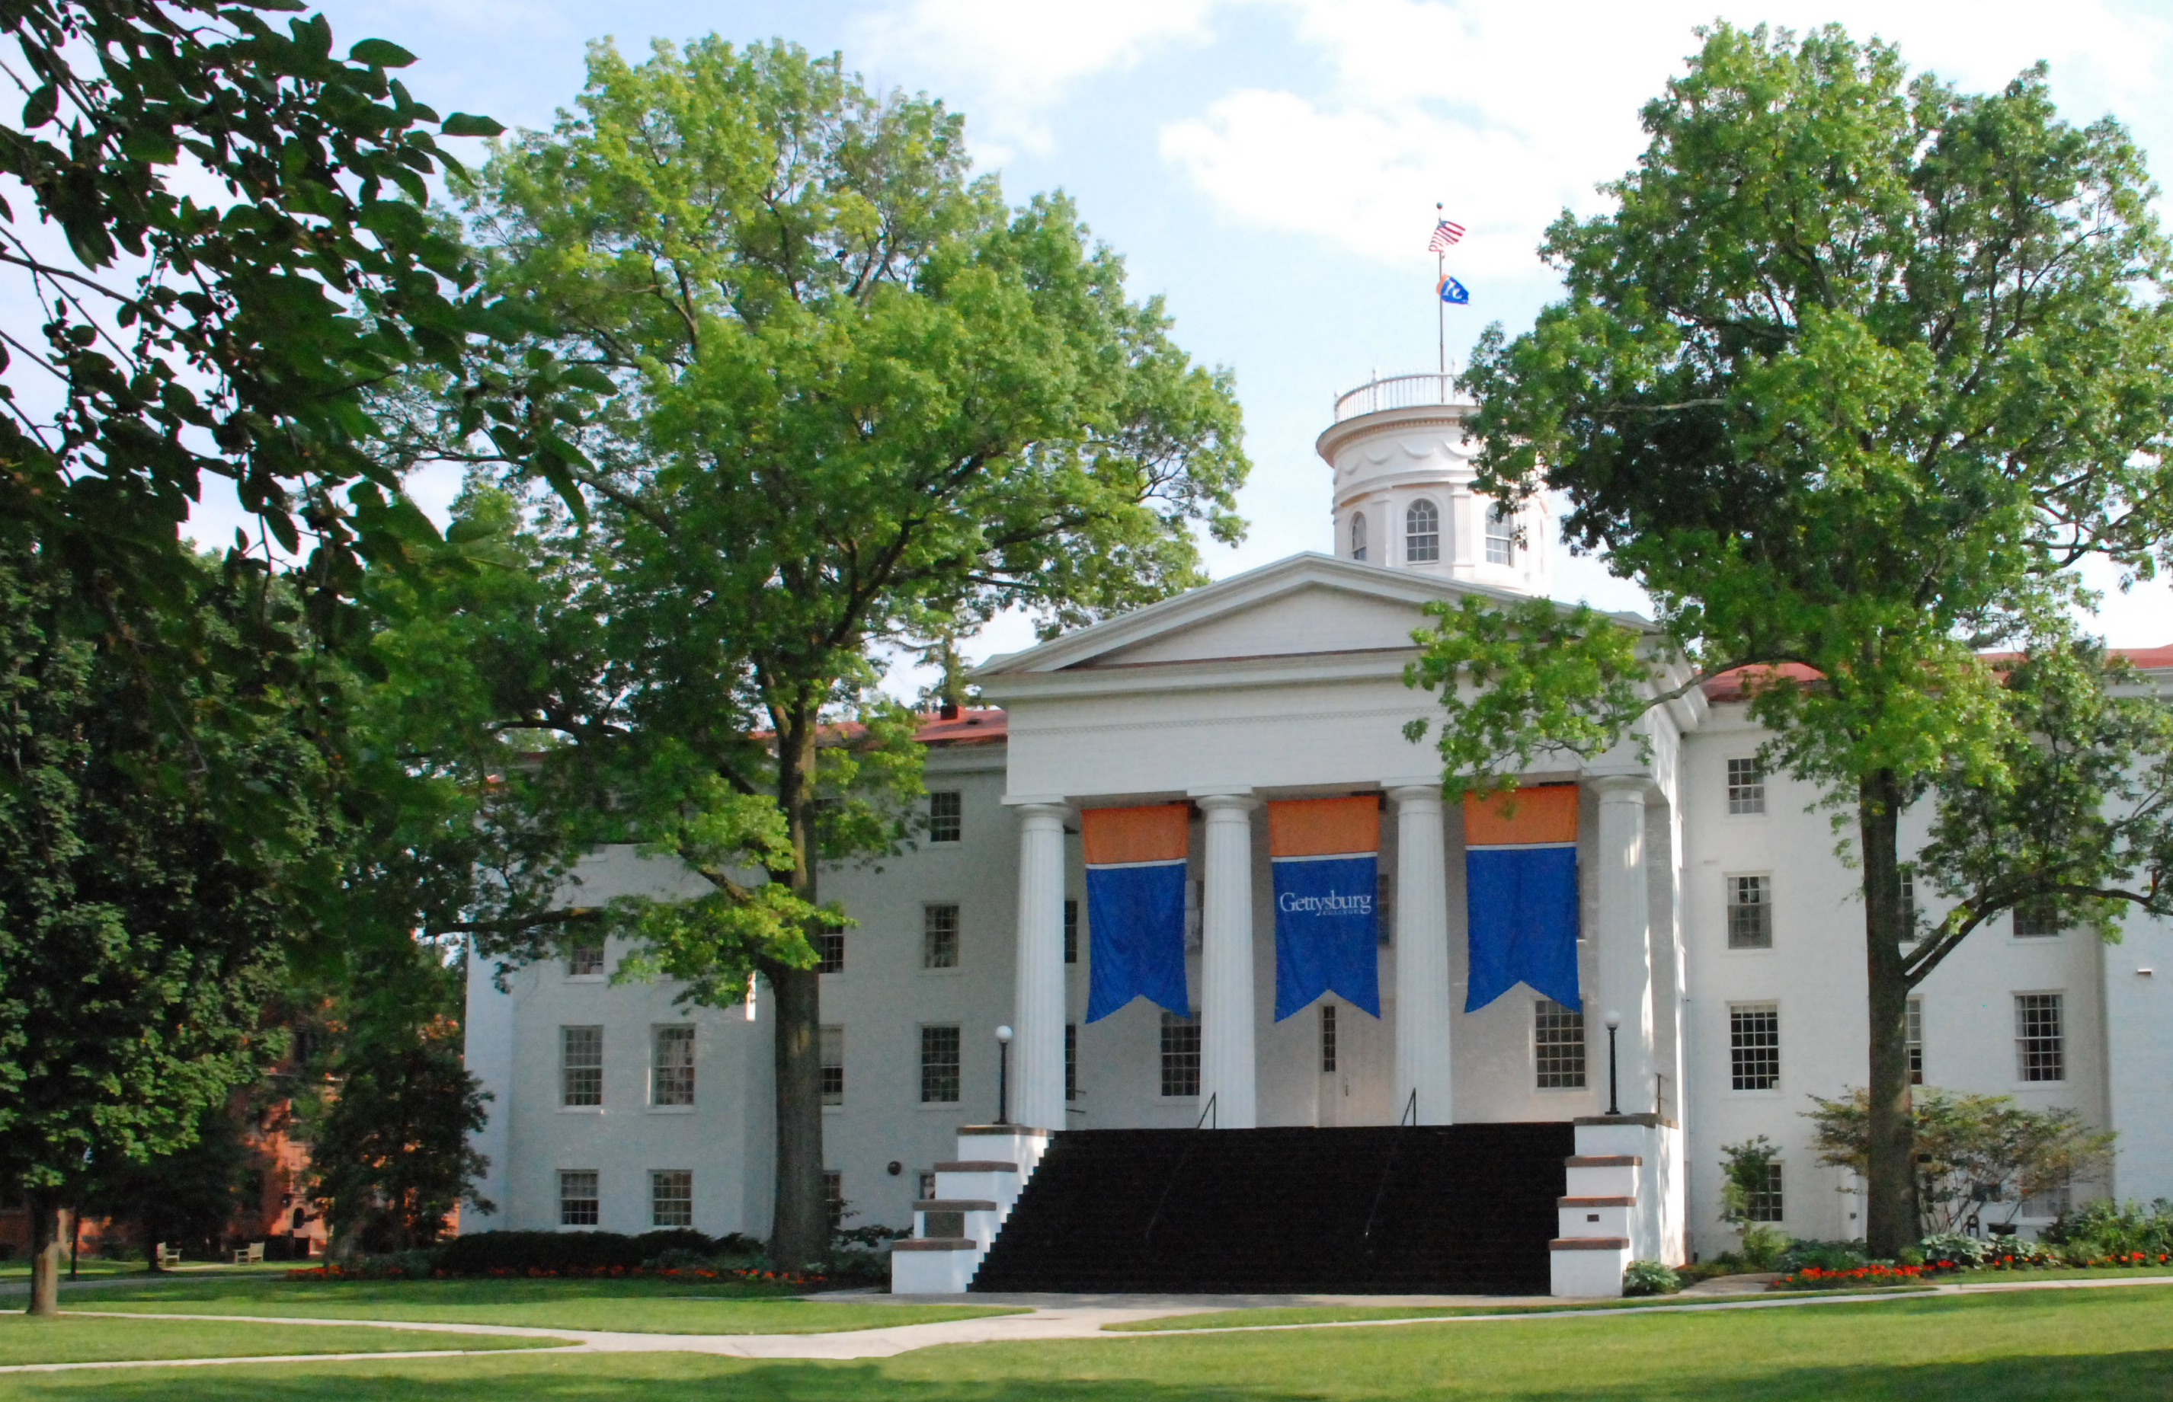
Planning & Partnerships:
Obtainable opportunities for increasing the intercultural competencies of all library employees
Miranda Wisor & Meggan Smith
Diversity & Inclusion Committee Co-Chairs
Musselman Library, Gettysburg College
Notes:
Gettysburg College is a residential liberal arts college with 2,600 students from more than 34 states and 38 countries. In 2016, GC conducted a campus climate survey titled “Gettysburg College Assessment of Climate for learning, living, and working which gathered feedback from campus students, staff, faculty and administrators. The assessment established baseline data on diversity and inclusion and directed the GC community toward opportunities to build on its strengths and develop a deeper awareness of challenges ahead.
Musselman Library employees participated in the campus climate survey and committed to exploring avenues to become a campus leader in issues relating to diversity and inclusion. In 2016, Musselman Library established the Diversity and Inclusion Committee which leads the library in promotion of educational and growth opportunities and ensures that the library’s work aligns with the campus commitment to diversity and inclusion in order to enrich the library climate for users and employees. I and my co-presenter are also co-chairs of the Diversity and Inclusion Committee. Please note that throughout this presentation, when we refer to library employees, we mean staff and professional librarians.

Slide 2
Intercultural Development Inventory (IDI)
Motivation
Around the same time the results from the Climate Study came out, the College started encouraging departments and groups on campus to participate in the IDI as part of their Inclusion Action Plans.
What is it?
A confidential survey that is designed to provide feedback on both perceived and actual levels of intercultural competence.
Participants receive an individual link to the survey, and after it is completed, the results are reviewed by a “Qualified Administrator” on campus. The QA meets with the individual privately to discuss the results and opportunities for growth.
Participation
Approximately 70% of library staff chose to take the IDI the first time it was offered.
It is offered to new employees on a rotating basis, and this summer individuals from the first cohort had the opportunity to retake the IDI to see their growth.
Notes:
Also in 2016 the College started encouraging departments and groups on campus to participate in the Intercultural Development Inventory (IDI).
The IDI is a confidential survey that is designed to provide feedback on both perceived and actual levels of intercultural competence.
Participants receive an individual link to their IDI survey. After they complete the survey, the results are reviewed by a “Qualified Administrator” on campus. The Qualified Administrator meets with the individual privately to discuss their results and to offer suggestions for growth. The idea is that you develop a “plan” to further your intercultural competence.
The IDI does cost money, but our Library Dean reached out to the Provost Office and received funding for library employees to take the IDI. Participation was optional, but highly encouraged – and we had approximately 70% of the library staff elect to participate during the first time it was offered.
We continue to offer the IDI on a rotating basis as new employees join the library. This summer individuals from the first cohort had the opportunity to retake the IDI to see their growth over the past three years.

Slide 3
Programming
Internal
“Town Crier” emails highlight events and opportunities to library employees
Film and discussion series
Recommended readings and discussions
Workshops on topics related to diversity and inclusion
Reporting out from conferences
Created “mindset list” using demographic data about incoming first-year students
Partnerships
Campus reading & discussion series
Book displays
Human Library, “Stop Bias at the Burg”
Invited experts on campus to present to library staff and student employees
Safe Zone Training
Interrupting Bias
Working with international students
Neurodiversity*
Notes:
After the Diversity and Inclusion Committee created, we got to work on creating opportunities within the library for employees to work on their IDI plans as well as connecting employees with opportunities and resources from outside the library. It should be noted that the committee is intended to serve as a resource and to take lead on a few initiatives each semester and coordinate with other groups to avoid overextension and burn out.
Because we recognize that all individuals learn in different ways, the committee has committed to providing a variety of types of opportunities for employee engagement and professional development including film screenings, shared readings, and invited guest speakers. Town crier messages are sent to all library employees provide a comprehensive list of programing and events occurring on campus that individuals can participate in. The committee has also created a Mindset List infographic that features data about incoming first-year students and is presented to all staff at the beginning of the academic year. Collaboration with other campus departments has been extremely helpful in generating growth opportunities and expanding the library’s engagement with campus. We invite guests from elsewhere on campus to the library for training opportunities and also seek out opportunities to partner with campus initiatives such as the Human Library that we have hosted the past two years as part of the campus-wide ‘Stop Bias at the Burg’ event.

Slide 4
Changes
Achieved
Library statement on diversity & inclusion
Resource box for neurodiverse students available for check out
More accessible furniture
Revised collection development policy
Revised recruiting process for staff and student positions
Ongoing
Move away from lunchtime meetings and events
Improve signage
Marketing of library initiatives related to diversity & inclusion
Increase library engagement in campus initiatives
Notes:
These learning opportunities have led to changes in our library, including developing an official library statement on diversity and inclusion, which is included on our website as well as on posters throughout the library.
With the help of our partners in academic advising and students with learning differences, our Users Services department acquired a resource box filled with a weighted blanket, fidget spinners, noise cancelling headphones, and more, that students can check out.
We revised our collection development policy.
We also revised our recruiting process for staff and student positions in order to get a more diverse candidate pool.
During a staff-led discussion on body positivity in the library, it was decided that we should move away from lunchtime meetings and events whenever possible, so this is an ongoing change.
We are in the midst of improving our signage, making it more accessible, and investigating having signage available in multiple languages.
We’re continually marking library initiatives related to diversity and inclusion and increasing the library engagement throughout campus.

Slide 5
Future Plans
More emphasis on student employees
Programming
Optional (paid) workshops
Weekly readings
Recruiting students for more high impact work and learning opportunities
Committee development
Reevaluate our diversity and inclusion statement
Pursue new partnerships around campus
Seek more professional development opportunities specific to diversity and inclusion
Questions? Contact us!
Miranda Wisor, mwisor@gettysburg.edu
Meggan Smith, mdsmith@gettysburg.edu
Presentation available in our institutional repository: https://cupola.gettysburg.edu/librarypubs/120/
Notes:
In the past, we have offered some programming and training opportunities for student workers in the library that mirror what is offered for staff, we plan to expand our student effort in the coming year. In addition to training sessions, the committee has committed to organizing brief readings for student workers to review during their weekly shifts in the library. Also, although our library employees come from a variety of backgrounds and countries, we recognize that student employees are more homogenous in the higher level positions, therefore we are continuing to revamp our recruitment procedures for these high impact work experiences. We also continue to pursue new partnerships by taking advantage of contacts on campus and being present at other events on campus. Finally, we continue to create opportunities to share-out lessons learned at conferences, such as the staff we have currently attending the IDEA Conference in Ohio and webinars like this today.
We welcome questions to our email addresses listed there. Also, this presentation and our speaking notes are available via our institutional repository. The address is also listed there.

