Slide 1
Accessible, Adaptable, Affordable: How OER and Low-Cost Materials can Future-Proof Your Courses
Gettysburg College June Pedagogy Institute 2020
Janelle Wertzberger (she/her)
Mary Elmquist (she/they)
Sarah Appedu (she/her)
Musselman Library Scholarly Communications Department

Slide 2
Today we will cover:
Context
Textbook affordability
Teaching online
OER
Zero-cost and low-cost materials
Faculty testimonials
Sarah Principato, Environmental Studies
Alecea Standlee, Sociology
Mercedes Valmisa Oviedo, Philosophy
15 minutes
15 minutes

Slide 3
Context: Textbook Costs at Gettysburg College
Notes:
In early Fall 2019, we conducted a campus-wide student textbook survey to learn how much our students spend on their course materials, how they try to reduce those costs, and the impact of textbook costs on student success. We presented the results at a Friday Forum in February and would like to review some of our findings in order to set the context for how textbook access and affordability was affecting our students before the economy was rocked by the pandemic. If you would like a complete description of our research questions, methodology, participant demographics, and results, you can access our slides and script as well as an executive summary in The Cupola, and we will share those links out after this session.

Slide 4
Almost 2/3 of participants spent more than $200 on books in Fall 2019
Notes:
The most common answer for money spent on books was $300, and we also saw that first-year students spent the most on average. Note that we asked how much they spent, not how much their books cost.

Slide 5
Students report that financial aid is not helping
Notes:
About half of our respondents report that they do receive financial aid but that they don't have any left to cover the costs of course materials. Only 8% said that they had some aid to cover materials, and only 3% said all of their materials were covered. Of Pell Grant recipients, students with the greatest financial need, 70% report not having any financial aid to cover book costs. Most students, even those with large financial aid packages, were paying for all of their books out of pocket. It's not yet clear how financial aid will be impacted by the pandemic, but it's probably safe to expect that this isn't going to get better.

Slide 6
Students reduce textbook costs in a variety of ways
Notes:
Only 1% of respondents said that they do not attempt to reduce their book costs. The most common strategies were renting their books and buying and selling used books.
However, first-generation students and Pell Grant recipients were the most likely to report that they share books with a classmate, check out books from the library, or not buy some of the required texts. We call these "coping strategies" that students use to make it work when they cannot afford the materials, leaving them with partial or no access. These strategies might become less available to these students in a remote learning environment, putting them at an ever greater disadvantage.

Slide 7
Book costs may affect some groups more than others
Notes:
Just as the strategies for reducing costs differed by group, so did the impact of these costs. While over half of our total response group indicated feeling the effects of book costs, first-generation students and Pell Grant recipients report the greatest effects of book costs. Respondents from both groups were more likely to report they had not purchased required books. Relatedly, first-gen students reported struggling academically at twice the rate of non-first gen students, and Pell Grant recipients were about three times more likely to report struggling academically because of the barrier of textbook costs.
And we have every reason to believe that not only has this problem gotten worse for these students because of the pandemic, but that more students will report struggling with the high cost of their course materials.

Slide 8
Students say $50 is a reasonable price for ALL books and materials for a single course
Notes:
Participants were asked how much they felt was reasonable to pay for all of their required books and materials per course. The most common response was $50, which is close to the frequently quoted $40 limit for low-cost courses used in other textbook affordability initiatives. This number is what we will use when talking about local low-cost courses.

Slide 9
Context: Teaching Online
Notes:
The affordability context was super important before March; the move to online classes exacerbated the problem.
Some students who didn't have problems with access before the switch suddenly did, when their books were stuck in their dorm rooms while they were off campus.
Other students who didn't buy materials in January may have been successfully using coping strategies early in the semester which suddenly stopped working. A couple examples:
Print reserve material – like full course textbooks on reserve in the library – were inaccessible
Sharing books with a classmate was now impossible
Some of these stresses were alleviated by stopgap measures. Thankfully, publishers removed paywalls to loads of copyrighted material in late March – but they are unlikely to do so again. That was a one-time gift! If your students were only able to continue to access assigned materials because publishers lifted the paywall, you should formulate a Plan B for next time.
Hopefully there won't be a next time. But assigning free and open materials avoids the problem altogether. It's important to recognize that whatever financial stresses students faced pre-COVID are likely to intensify now, as they are likely to have reduced ability to earn money in the summer, more pressure to contribute to household finances, etc.

Slide 10
Open Educational Resources
(OER)
Notes:
One way to address a whole slew of these issues—both recently arisen and ongoing long-term—are open educational resources, or OER.

Slide 11
What are OER?
Free!
No cost
Available online
No copyright restrictions = adaptable
Notes:
So, what are OER?
First, you might ask, what does “open” mean in this context?
When we say “open” we mean that OER are free
They are free of cost for users
and accessible online for download, use, and redistribution (although many are also available to purchase in low-cost printed versions)
They are also free of copyright restrictions, meaning they can be freely adapted to your courses’ needs
Well, “that’s great”, you say, “but what kinds of materials can be OER?”
OER can take the form of all kinds of teaching and learning materials—from textbooks, to digital labs, to slide decks and lecture notes, to test banks, and even homework software.

Slide 12
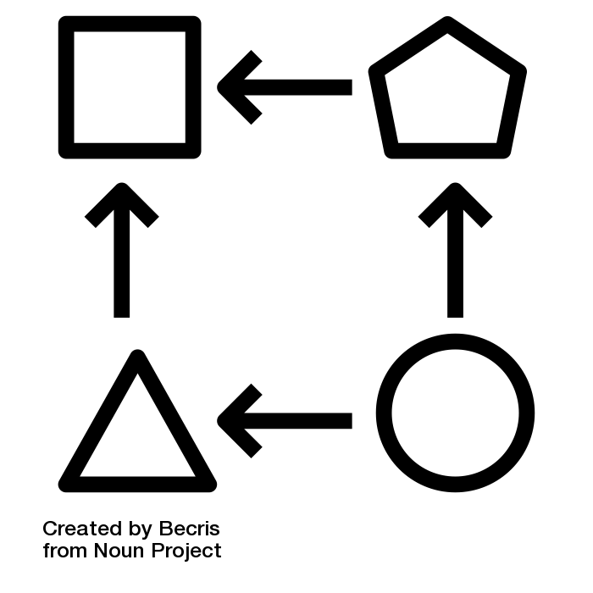
Benefits of OER: Students
Notes:
OER benefit students in several ways, some of which you may have started to guess…
Perhaps most obviously, OER are affordable for students. There’s really no better cost option for all of our students than ”free”
Secondly, because they’re accessible online, in most cases, students don’t have to worry about not having the book with them. They also know that access to their textbooks won’t be lost at the end of the semester. I want to mention that for right now, I’m talking about students having digital access—which isn’t quite the same thing as digital accessibility. While I’d love to be able to say that OER are all perfectly created with accessibility in mind, like most digital media, not all OER are there yet. But..
Since OER are adaptable, there is always the opportunity for users to edit them to add further accessibility, and there are communities dedicated to just that. The adaptability of OER also provides a unique opportunity to reflect the lives, identities, and issues facing students right now. This can mean anything from updating a portion of a textbook to reflect the recent changes in the US social landscape resulting from the murders of George Floyd, Breonna Taylor, and countless Black Americans, to simply changing the names and pronouns used in example word problems to be more representative of the students in your classroom. Students can also participate in these kinds of adaptation—allowing them to raise their own voices in the scholarly conversation.

Slide 13
Benefits of OER: Teachers
Notes:
So a lot of the benefits to students extend to faculty as well, but I want to point out some unique advantages for teachers:
Adaptability means you can completely reorder or remove chapters of a book to suit the structure of your course. Or you can mix and match chapters from different open textbooks. Just a few weeks ago, our department hosted a session dealing with how to adapt open textbooks, and we’ll have a link to the recording from that session available with our additional resources, if you’re curious about that process.
And you’ll know that students have access their textbook, before class starts, during the semester, and after the final exam—regardless of their financial situation.

Slide 14
Finding OER
Notes:
Finally, I want to take just a moment to touch on how you can go about finding OER for your classes.
There are some great resources out there if you want to go searching yourself. We highly recommend the Open Textbook Library, which focuses on collecting complete textbooks that are either in use at multiple higher-ed institutions or written by folks affiliated with a college or university, scholarly society, or professional organization. Many of the books in this library also have reviews written by faculty (including some from Gettysburg College.) If you’re looking for ancillary or other open materials, OER Commons and OASIS both have intuitive searches and large libraries.
But, probably the easiest way for you to find OER will be to ask your friendly librarian! You can contact your department’s liaison or let one of us know what you’re looking for, and we’ll do our best to find you some likely options. We would rather you be able to focus on evaluating OER and designing your courses, not finding possible resources!
Now, we’ll admit that OER is a growing area—and that as of now, there’s not a perfect open textbook out there for every class. To that point, I’m going to hand it back over to Janelle to talk a little about low-cost options you can use.

Slide 15
Low-cost Course Materials
Notes:
Coronavirus has not suspended copyright - whatever rules became more elastic in March and April have tightened up again now.
Ex: Internet Archive opened up and created a “National Emergency Library” - and publishers and authors are now suing them for theft. So the doors are CLOSING.
That said, there are a some strategies you can use if you want to lower course costs while teaching with commercial materials. There are two strategies I want to highlight, as well as a quick list of other recommendations.

Slide 16
Course Reserves
Notes:
Our course reserves service can help students access your texts under some conditions.
First, we prefer to scan reserves items and link them to your Moodle site. But we have to follow copyright law, so we can’t scan entire books. A rough rule of thumb is 10%, but it depends. Journal articles or book chapters are generally okay.
You can scan and load readings into Moodle yourself, but be aware of copyright rules as you do so. If you use our service, we will check copyright permissions and pay for clearance if required. We also make sure that only readable pdfs are uploaded, which is important for screen readers used by some students.
We also place physical items on reserve, which is the best option if you need to share an entire book with students. This is a popular option for big textbooks, and many students rely on those book copies in the library. The obvious downside is that this approach doesn’t work when we are have online classes. We are still considering how to balance safety and access in the fall, but as of now, are planning to continue this service.
If you're going to use Course Reserves, submitting requests sooner is better. If you already know you'll want specific material on reserve regardless of whether you're teaching online or in person, you can submit those as soon as now.

Slide 17
Library-licensed materials
Journal articles to which we already subscribe
Library ebooks, esp with multi-user licenses
Notes:
Many professors assign published journal articles as readings. If you can consider choosing articles from journals that are already in our subscription collection, that helps – because it saves time spent making copyright determinations and also saves money that we almost always pay to the Copyright Clearance Center to keep us legal.
Ebooks are becoming more popular, and we have about 300,000 already in our collection. Note that licenses vary, and books that carry a single user license may only be helpful to one or two students. If most of your students buy the book and you know only a couple can't, a single user license may get the job done. But if you want to replace an assigned book purchase with a library ebook, you should check to see if we have a multi-user license or if we can obtain one.
A caveat – not all books have library ebook licenses, and not all have MULTI-USER licenses available. But we can check.
Also – the existence of a Kindle edition in Amazon is not an indicator that there is also a library ebook license. The ebook markets for individual consumers and institutions are separate. (just like the residential and institutional toilet paper supply chains, haha!)

Slide 18
Other strategies to lower cost
Older/different editions
Eliminate cost of some assigned items
Seek open or zero-cost alternatives
Try to keep total cost under $50
Notes:
Really quickly... some other strategies to lower cost:
Let students use older or different editions
If you can eliminate the cost for some assigned items out of a longer list, that helps the bottom line
Seek open or zero-cost alternatives to the texts you currently teach
To reinforce the number that Sarah shared earlier... our students say that $50 per course is a reasonable cost.
And final reminder … if you are chafing against copyright constraints, you might be ready to shift to using OER! It doesn't have to happen all at once. We can consult with you about a workable transition.

Slide 19
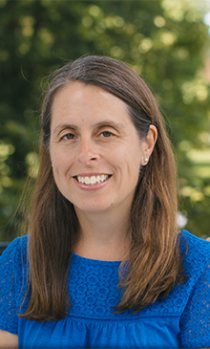
Dr. Sarah Principato Environmental Studies
Dr. Alecea Standlee Sociology
Dr. Mercedes Valmisa Oviedo Philosophy
Notes:
Three of our colleagues have joined us to talk briefly about their use of open, zero-cost, or low-cost materials in their courses – we have all categories covered and hope you find an approach that could work for you!

