Slide 1
The DH Toolkit: A Collaborative, Open, and Extensible Experiment in Pedagogy
R.C. Miessler and Kevin Moore, Gettysburg College
DLF Forum 2020 Lightning Talk
This work is licensed under a Creative Commons Attribution 4.0 International License.
Notes:
R.C. Miessler: Hi, and welcome to our DLF 2020 lightning round talk, “The DH Toolkit: A Collaborative, Open, and Extensible Experiment in Pedagogy. I'm R.C. Miessler, Systems Librarian, and with me today is Kevin Moore, Research, Instruction, and Online Learning Librarian.

Slide 2
A Very COVID Summer
Our Digital Humanities research program was cancelled due to COVID-19
We wanted some sort of high-impact learning experience for students
We needed tutorials for flipped DH instruction in the fall
The summer of 2020 became an experiment in developing skills required to create pedagogical materials for DH tools and concepts
Notes:
Miessler: Normally our summers in Gettysburg College's Musselman Library are busy running the Digital Scholarship Summer Fellowship, our Digital Humanities research program for undergraduates. However, in 2020, COVID-19 ruined our plans. We still wanted some sort of high impact learning experience for students interested in the Digital Humanities. We also knew we needed tutorials for flipped DH instruction in the fall semester. From this we decided to create a team of students and librarians to create online learning objects for DH tools and concepts, turning our usual summer experience into an experiment in learning about pedagogy.

Slide 3
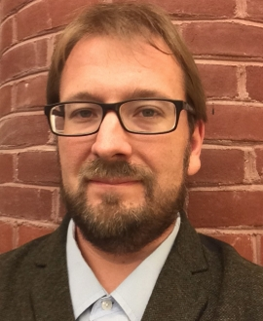
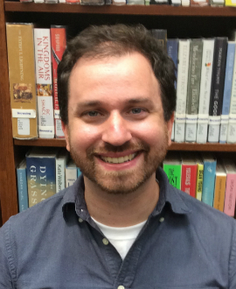
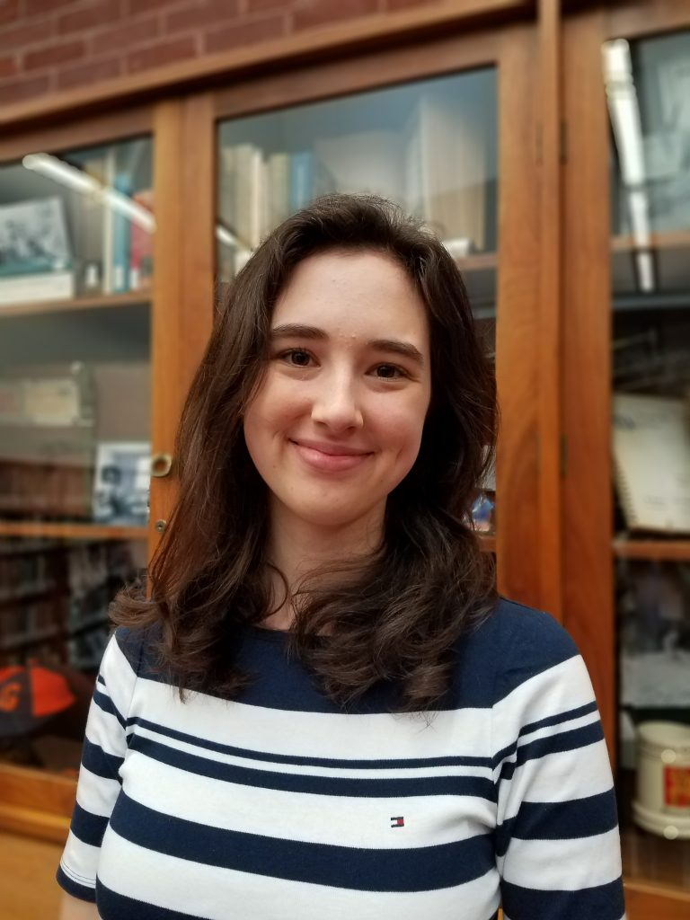
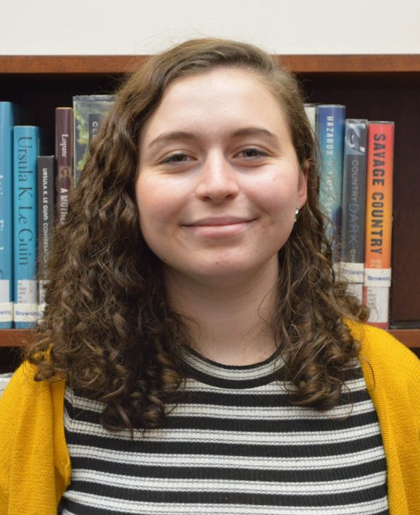
Team
R.C. Miessler
Systems Librarian and Digital
Humanities Coordinator
Kevin Moore
Research, Instruction, and
Online Learning Librarian
Emma Lewis ’20
Senior Digital Scholarship
Program Assistant
Emma Poff ’22
Digital Scholarship
Program Assistant
Notes:
Kevin Moore: Our team is R.C. and myself, as well as two students who had previously completed our summer fellowship program and were already familiar with some foundational DH tools and concepts. R.C. and I leveraged their existing knowledge while introducing principles for designing pedagogically sound online learning content.

Slide 4
Logistics
Weekly Schedule
Workflow
Project was 10 weeks
Students worked 20 hours/week
One-hour meeting on Monday mornings to plan
One-hour meeting on Thursday afternoons to share
Basecamp for project management
Microsoft OneDrive for sharing materials
WordPress site for publishing content
Notes:
Moore: We had 10 weeks for the project and students worked 20 hours a week during that time. Their wages were paid using funds from a Mellon Foundation grant Gettysburg College received in 2017. Each week, we had to 60 minute check-in meetings as a group. We used Monday mornings to assign tasks for the week and talk about next steps. And we used Thursday afternoons to share our work, receive feedback and discuss new readings we'd done. For our workflow, we used Basecamp to track our progress and communicate outside of regular meeting times. As we generated materials like lesson plans, scripts and video files, we uploaded everything to a shared Microsoft OneDrive folder, and we published our content on a WordPress site hosted through Gettysburg College.

Slide 5
Process
Weeks 1 & 2
Week 3
Weeks 4–10
Developing
new content
Background readings
Topic/tool selections
Environmental scans
Wireframing
Site creation
Gather content
to reuse
Add content to
WordPress site
Share and receive
feedback
Notes:
Moore: Big picture, the project ended up looking kind of like this, our group used weeks one and two to create a plan. We discussed best practices for creating pedagogically sound video tutorials and decided which DH tools and concepts we wanted the toolkit to cover. The next step was to assign tools and topics to individual people. The students tackled the majority of these, but R.C. and I were working on them too, and then see what instructional content or documentation already existed. By week three, we were ready to create a wireframe collaboratively and begin developing the WordPress site where the content would live. A lot of the work in weeks four through 10 follow this iterative process of finding existing instructional materials, developing our own materials, uploading content to our WordPress site and sharing with the group in order to receive feedback.

Slide 6
Student Experiences
“This position helped me to develop more experience using the digital tools that I previously knew the basics of or little about. Collaborating with librarians and other student employees contributed to the development of communication and collaboration skills in a professional workplace.” – Emma Poff ‘22
“At the start I had a lot of questions and checked in frequently to make sure that I was on the same page as everyone else. Once I felt more comfortable doing this work, I was able to take the reins.” – Emma Lewis ‘20
Notes:
Moore: At the end of the project, we sent an assessment survey to both students in order to learn more about how they felt the process went. We've included a couple key quotes here, but the biggest takeaway was that they both appreciated the intensively collaborative nature of the project experience.

Slide 7
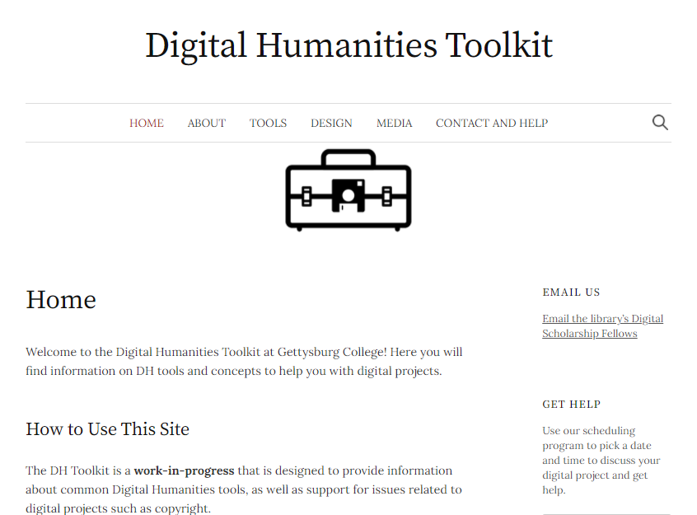
Next Steps
Deploy to students doing digital projects
Solicit feedback to assess content and usability
Extend by adding tools and concepts
Present to campus community
Notes:
Miessler: So what's next? Right now we're deploying it to students doing digital projects in the classroom. We are planning to use feedback we receive from our users to assess its content and usability, and add additional DH tools and concepts. Finally, we plan on presenting it to the campus community through workshops.

Slide 8
Thank You!
For more information, questions, comments and feedback, please check out the toolkit, and feel free to contact us!
DH Toolkit: https://dh.sites.gettysburg.edu/toolkit/
R.C.: rmiessle@gettysburg.edu
Kevin: kmoore@gettysburg.edu
Notes:
Miessler: Thank you for your time, please see our PowerPoint for additional links, and email us if you have questions or comments.

Slide 9
Digital Humanities at Gettysburg
Digital Scholarship Summer Fellowship 2019 website – summer curriculum and student projects
“Dreaming Big: Library-Led Digital Scholarship for Undergraduates at a Small Institution” – book chapter about the 2016 DSSF cohort
“Digital Scholarship, with Undergraduates, in the Library” – DLF Forum 2017 presentation

Slide 10
Background Readings
Articles and chapters read by the project group during the summer:
“Toward a Critical Black Digital Humanities” by Safiya Umoja Noble
“How Not to Teach Digital Humanities” by Ryan Cordell
“Writing Clear Learning Objectives”
“Best Practices for Online Video Tutorials: A Study of Student Preferences and Understanding” by Melissa Bowles-Terry, Merinda Hensley, and Lisa Janicke Hinchliffe

